Slide 2
Louis G. Hulsey
Presents

Slide 3
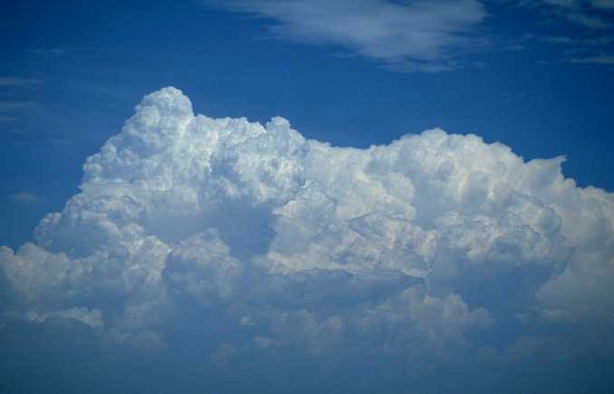
When God Became A Man

Slide 4
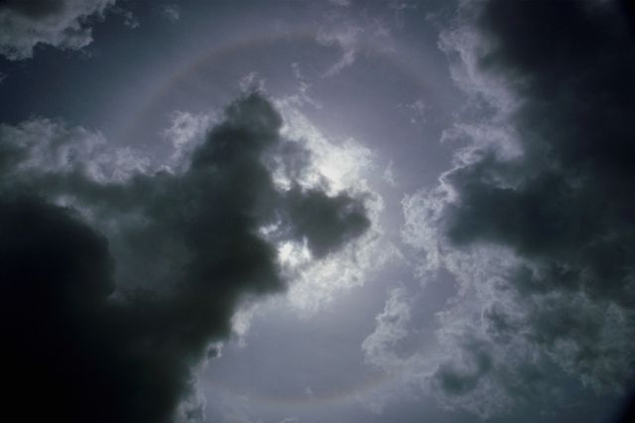
Notes:
Pastor: For a moment, leave the bonds of this mundane world.

Slide 5
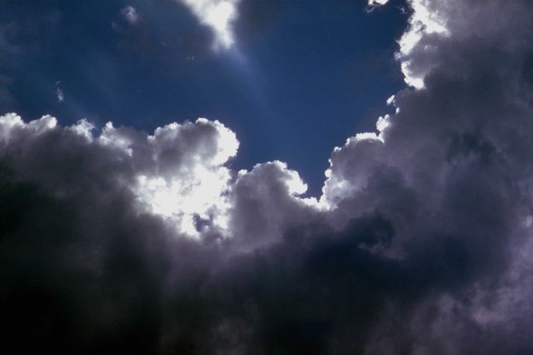
Notes:
Leave the cares of life and the carnal pressures behind you

Slide 6
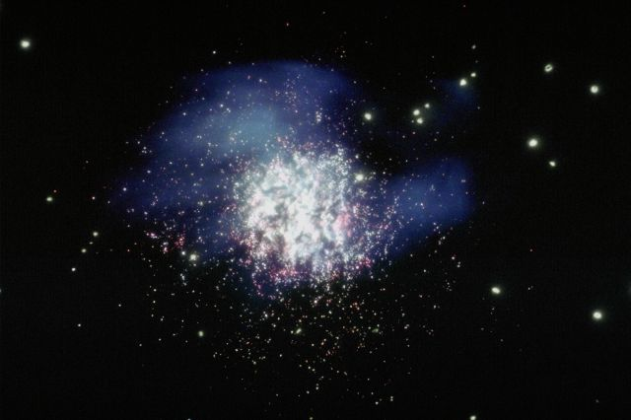
Notes:
and enter reverently into the realm of the spirit.

Slide 7
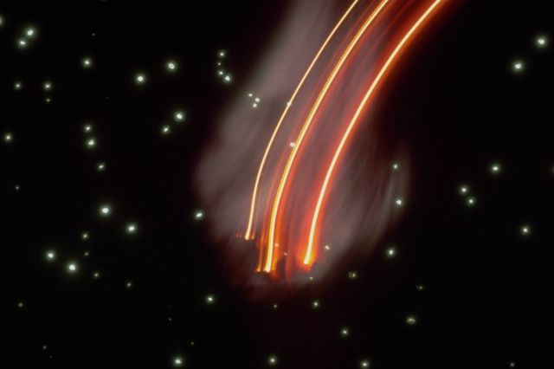
Notes:
Allow God to open your eyes for moment "in the Spirit" and see a little of His glory.

Slide 8
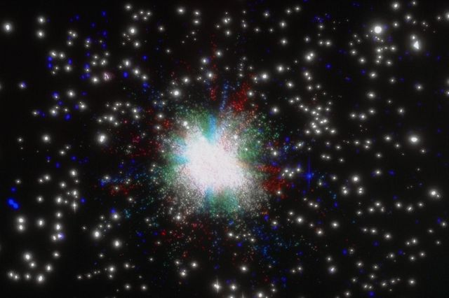
Notes:
Fall before His presence in awe and wonder as Isaiah did when he saw himself before the throne of God and cried out, "Woe is me, for I am a man of unclean lips and I dwell in the midst of an unclean people."

Slide 9
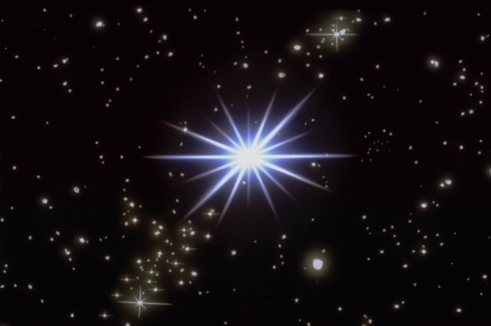
Notes:
See the glory of God proceed from His throne and hear His voice echo "I am Alpha and Omega." Hear James worship Him and call Him "the Father of lights, with whom is no variableness, neither shadow of turning."

Slide 10
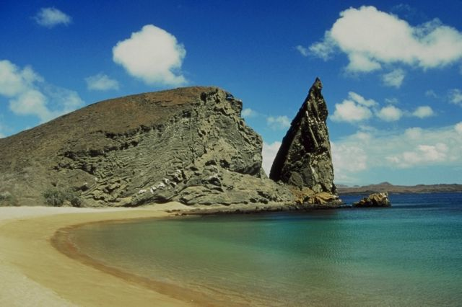
Notes:
Lou: God is holy. Holiness is His moral character.

Slide 11
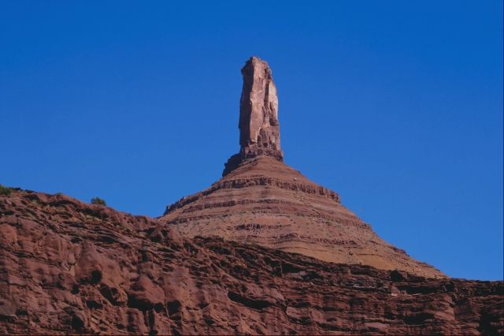
Notes:
God is eternal. He never changes.

Slide 12
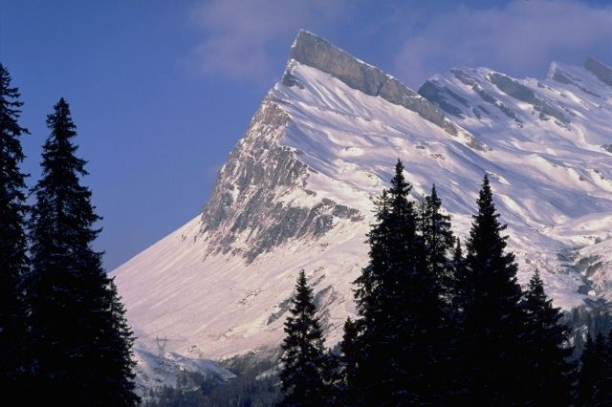
Notes:
God is altogether just and righteous.

Slide 13
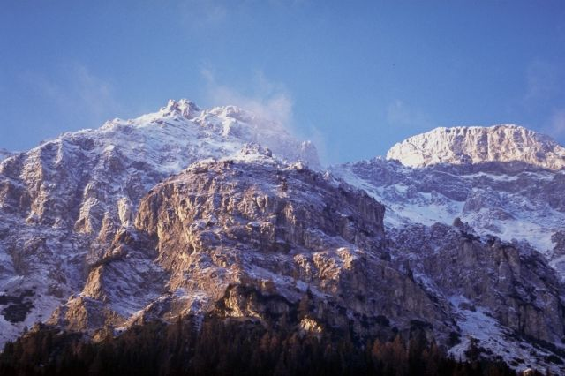
Notes:
God is Absolute Truth.

Slide 14
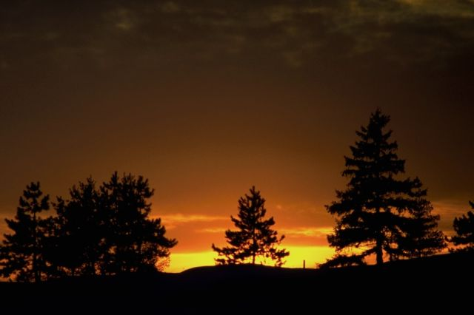
Notes:
God is Absolute Love. He will never be unjust, unholy, unrighteous, untruthful, or unloving.

Slide 15
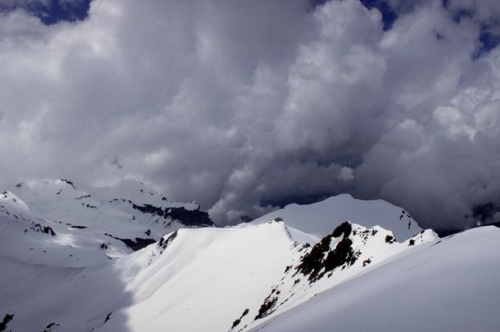
Notes:
He is transcendent above all the universe,

Slide 16
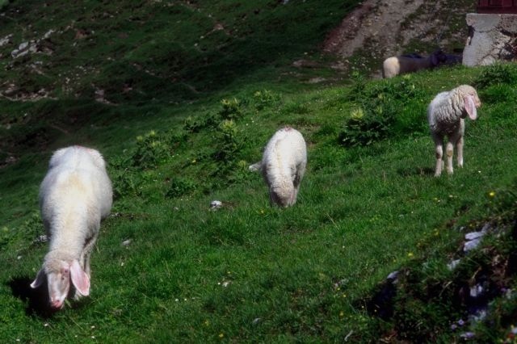
Notes:
yet imminent in every part of it.

Slide 17
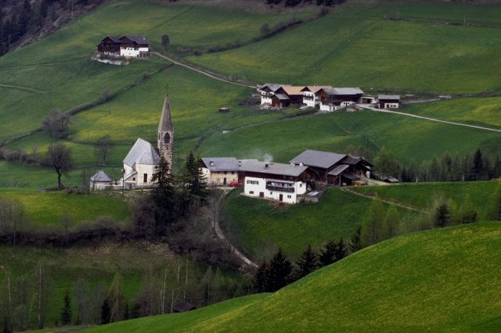
Notes:
Pastor: How could a God who is eternal and unchangeable change and become a man?

Slide 18
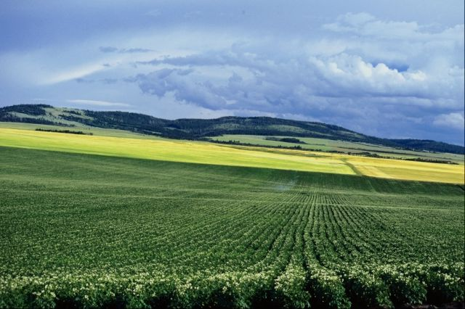
Notes:
How could a God who is absolutely just and righteous, have mercy?

Slide 19
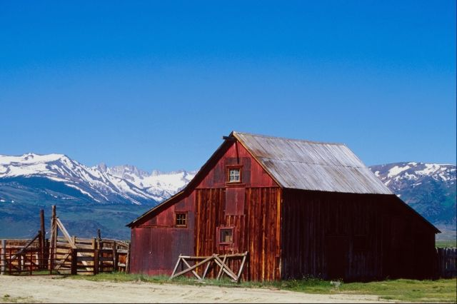
Notes:
How could a Creator transcendent above all the universe become a created being created by Himself and live subject to the laws of His own creation?

Slide 20
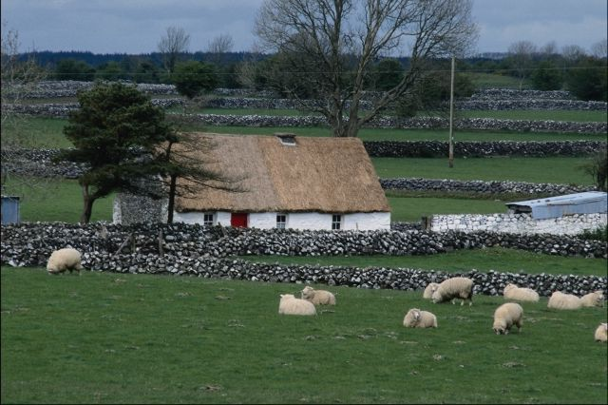
Notes:
How could a God who has delegated His authority to a man who lost it, regain it and still be just?

Slide 21
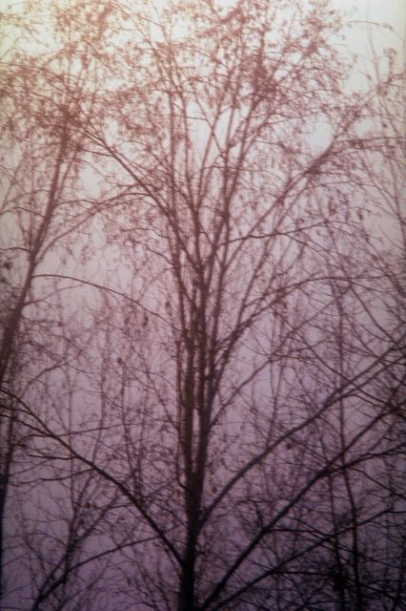
Notes:
These questions are what Christmas is all about.

Slide 22
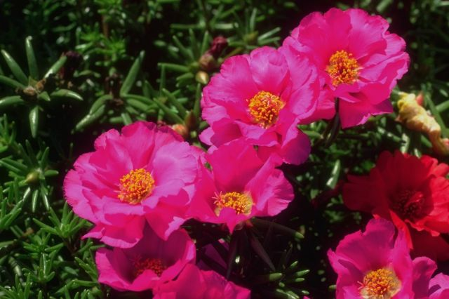
Notes:
Christmas is about love.

Slide 23

Notes:
It was love that caused God to send His Son to earth.

Slide 24

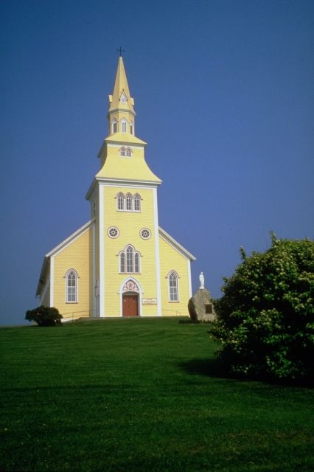
Notes:
He came to order and establish His Kingdom.

Slide 25
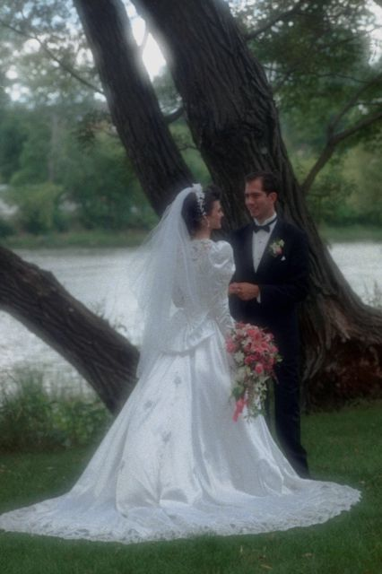
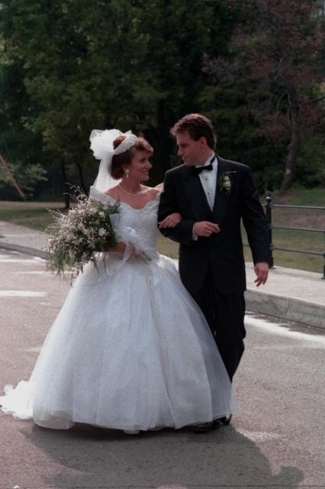
Notes:
He came to be formed in us, in our families,

Slide 26
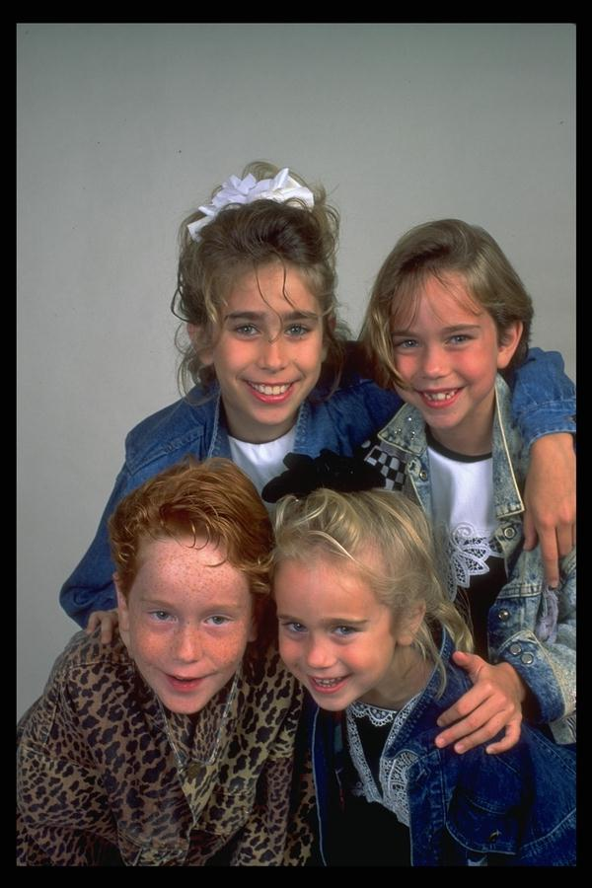
Notes:
…in our children,

Slide 27
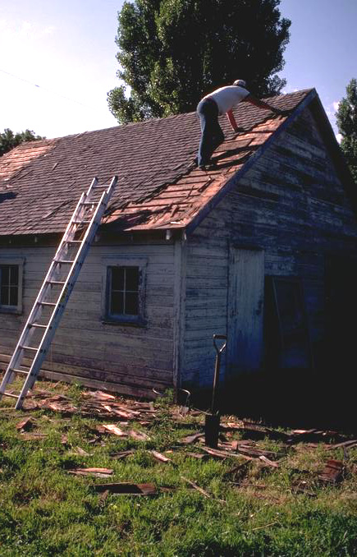
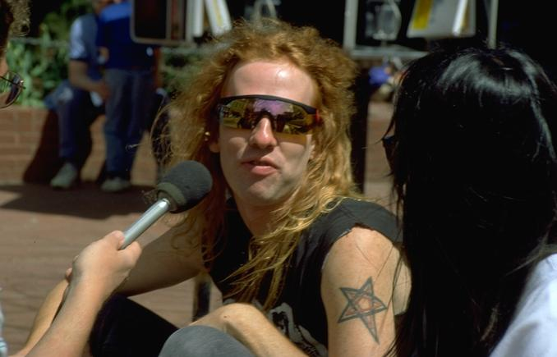
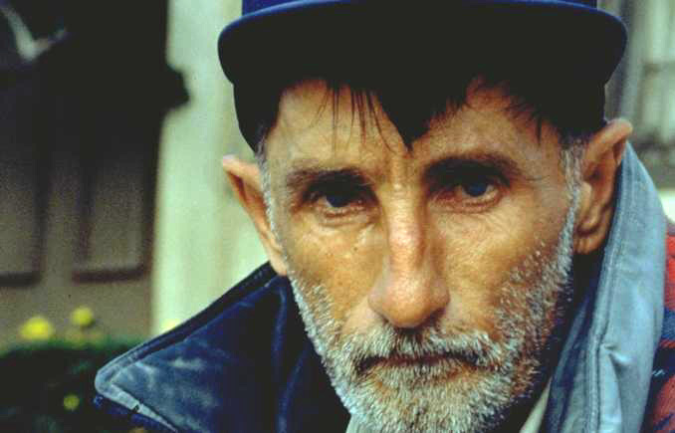
Notes:
…and in our world.

Slide 28
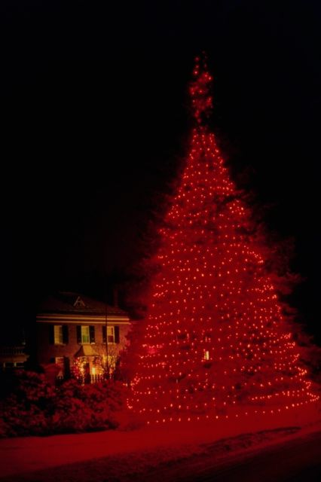
Notes:
Lou: The story of Christmas did not begin with the birth of Jesus in Bethlehem nor with the announcement of the angel to Mary.

Slide 29
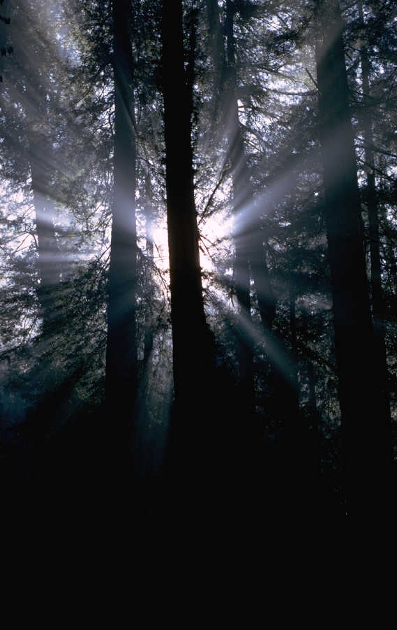
Notes:
The story of Christmas began in eternity in the heart of God. Jesus existed in eternity as God and in the presence of God before He came to earth. He is Jehovah. Peter tells us that His coming to earth the first time as a babe was "foreordained before the foundation of the world."

Slide 30

“Of the increase of His government and peace there shall be no end, upon the throne of David, and upon His kingdom, to order it, and to establish it with judgment and with justice from henceforth even forever.”
Isaiah 9:7
Notes:
Jesus came to the world to the world to order and establish His kingdom, the Church. Isaiah prophesied that Messiah would come, “upon the throne of David, and upon His kingdom, to order it, and to establish it with judgment and with justice from henceforth even forever.”

Slide 31
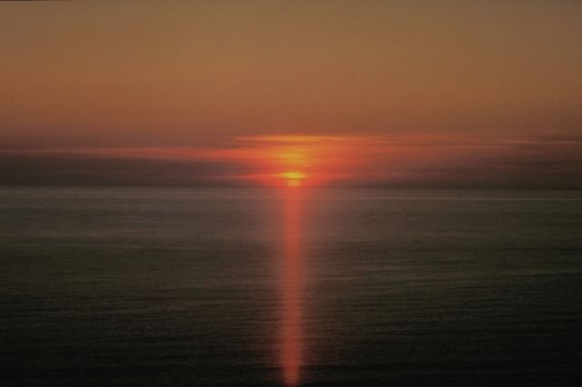
Notes:
The fact that God became a man is a great miracle.

Slide 32
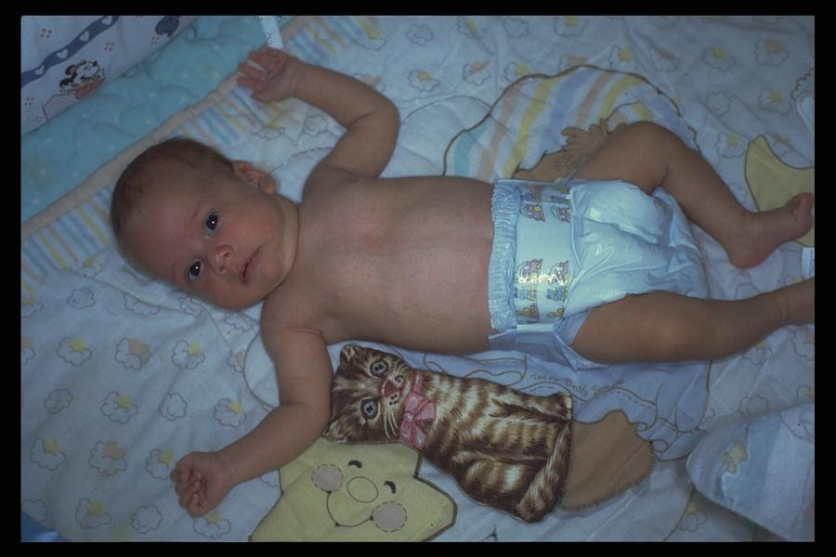
Notes:
He who was Creator became the created. He who is eternal became temporal. He who was omnipotent became weak. "For he hath made him to be sin for us, who knew no sin; that we might be made the righteousness of God in him."

Slide 33
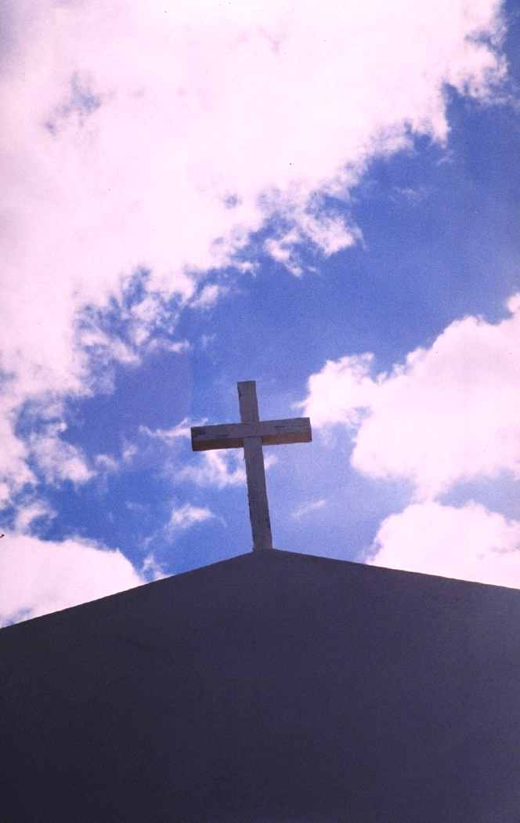
Notes:
The greatest miracle of all is that when we accept the lordship of Jesus by faith, God is born in us.

Slide 34
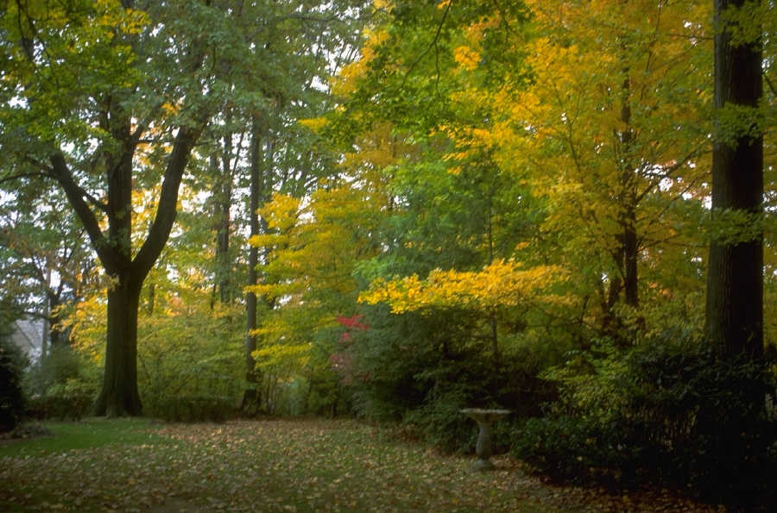
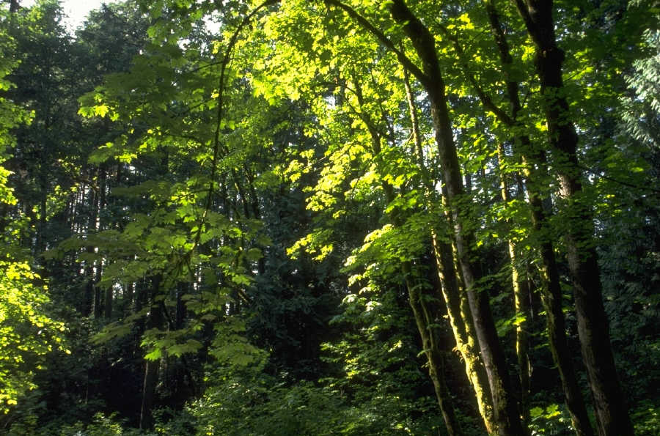
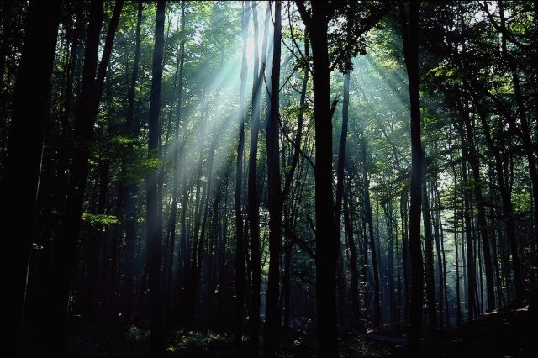
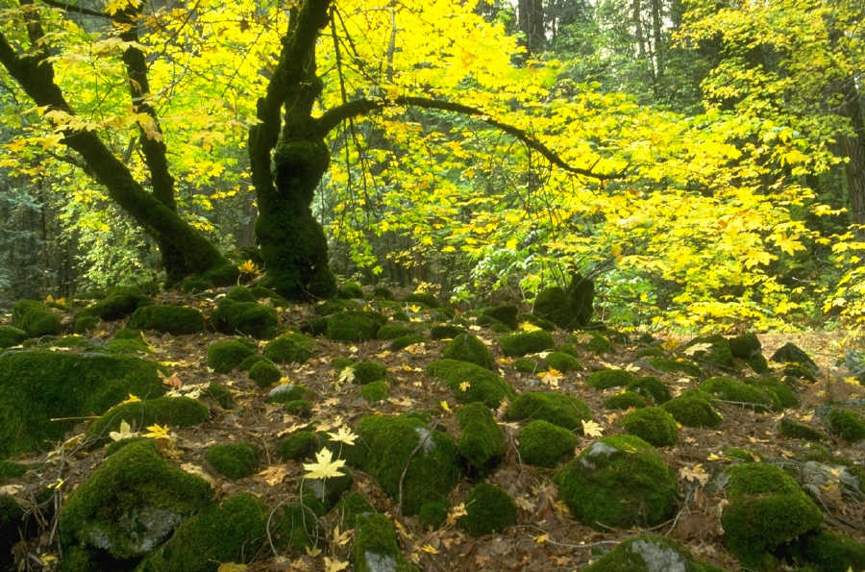
Notes:
Pastor: In the Garden of Eden, Adam and Eve had intimate fellowship with God. They were God's highest creation on earth.

Slide 35
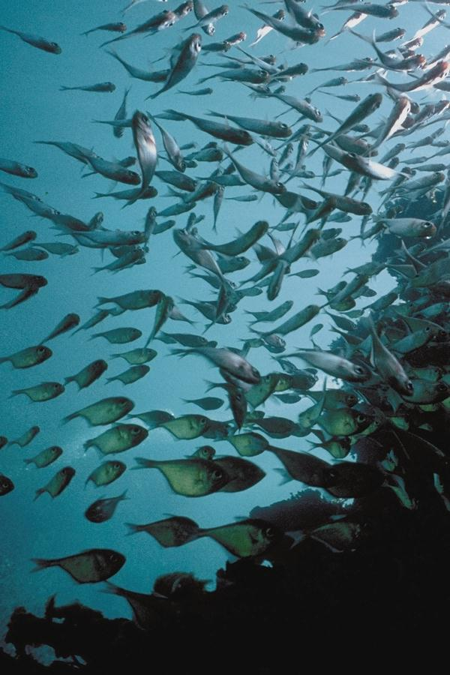
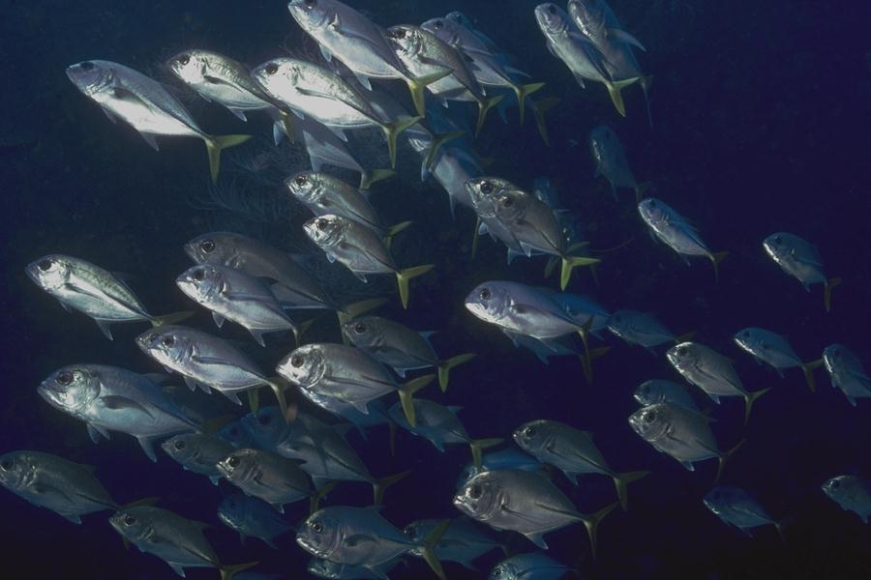
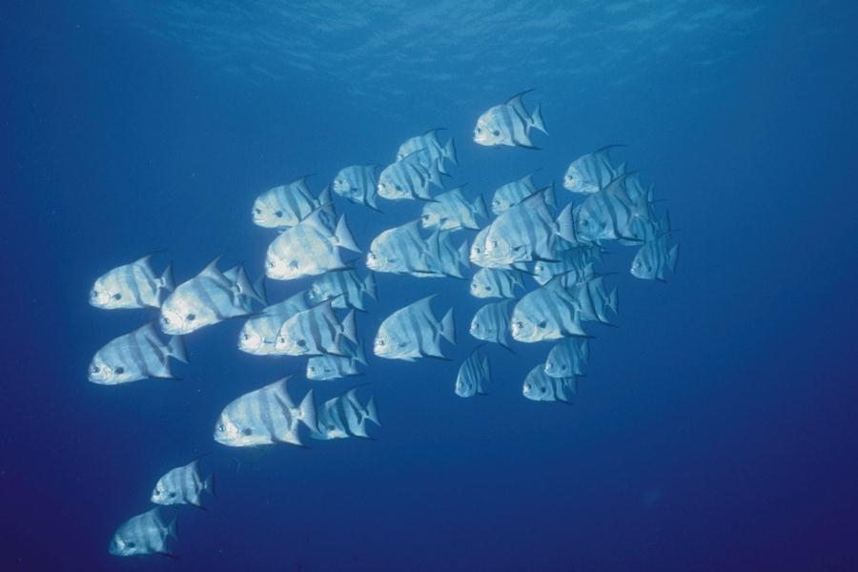
Notes:
Adam and Eve had the nature and image of God. They were God's under-rulers in the earth. Genesis 1:26 says, "And God said, Let us make man in our image, after our likeness: and let them have dominion over the fish of the sea,

Slide 36
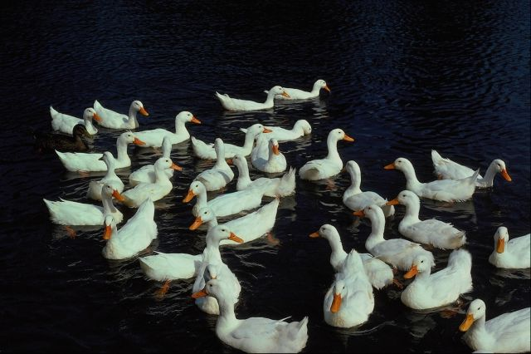
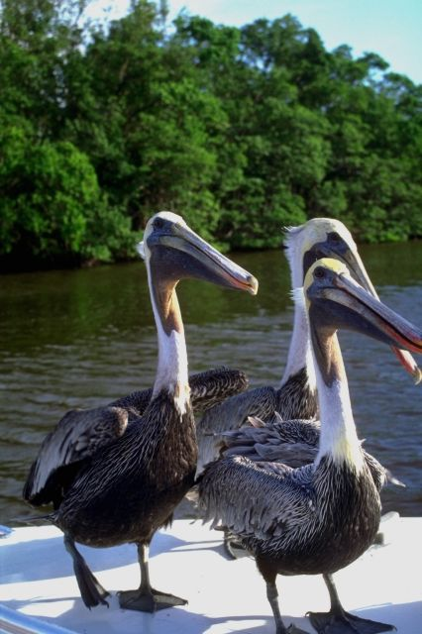
Notes:
and over the fowl of the air, and over the cattle, and over all the earth, and over every creeping thing that creepeth upon the earth."

Slide 37
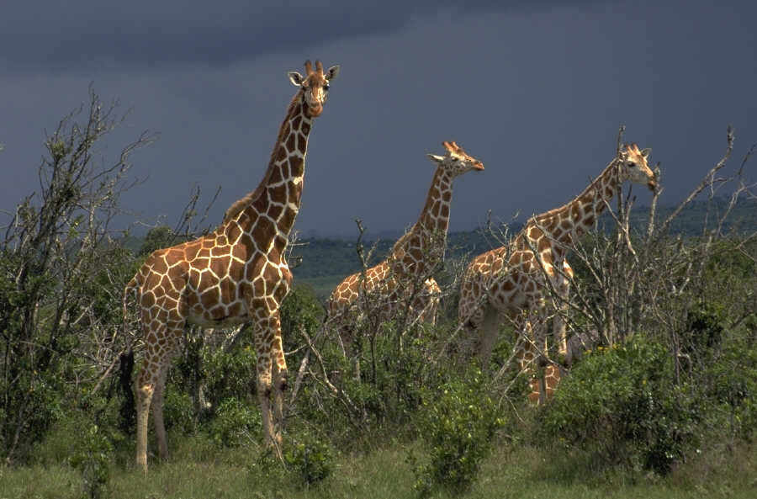
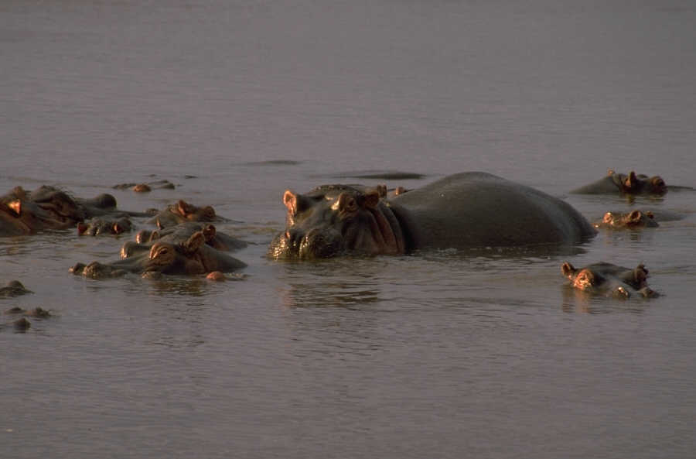
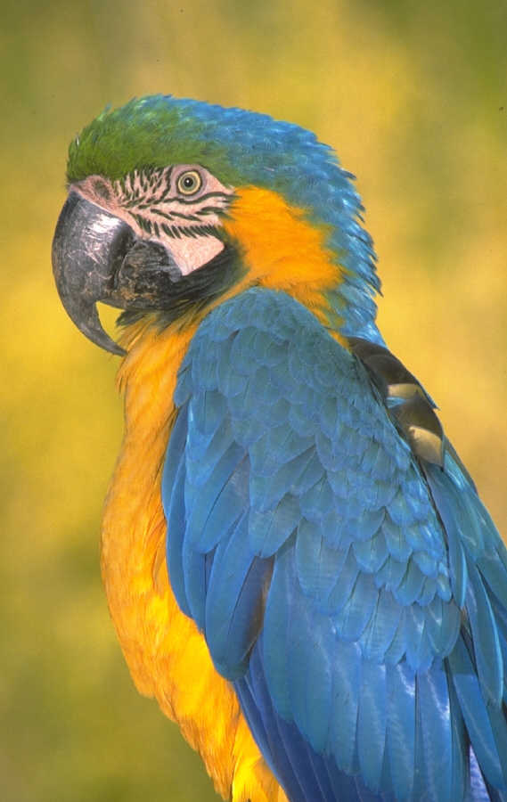
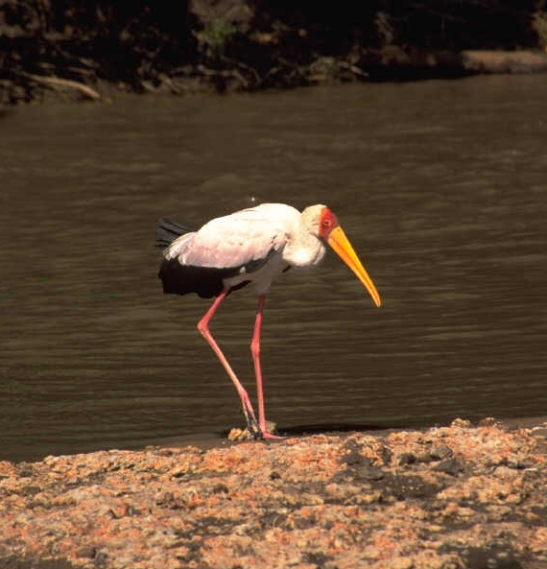
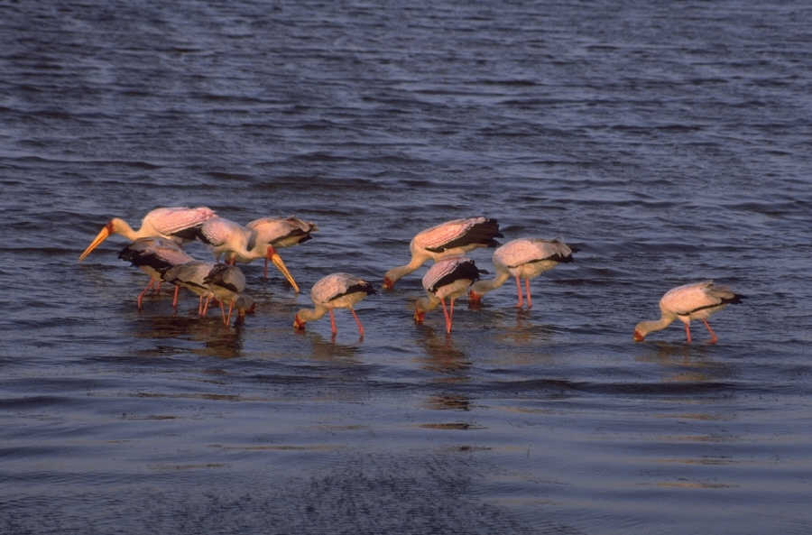
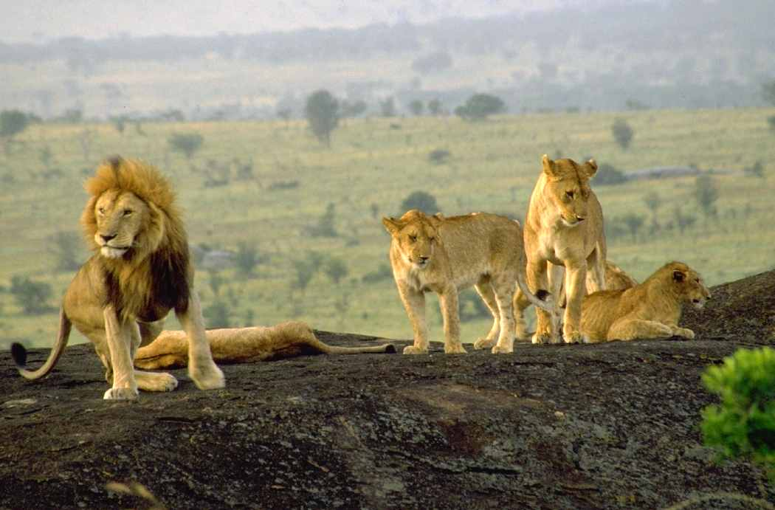
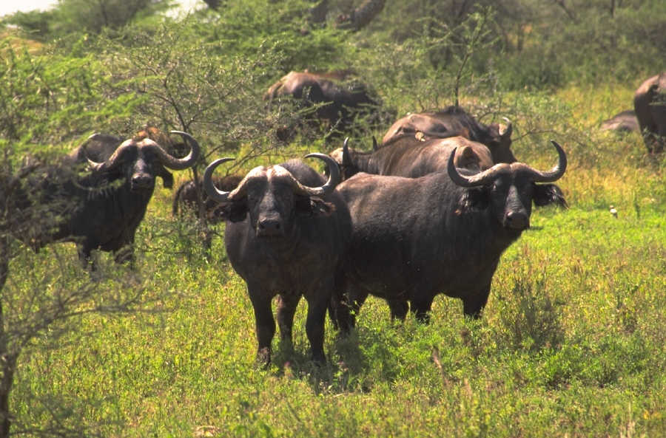
Notes:
All the creative power of the mind of God was at Adam's disposal. All his needs were supplied. He had open communion with God in the realm of the spirit. He had the ability to name and remember thousands of different types of plants and animals in the earth.

Slide 38
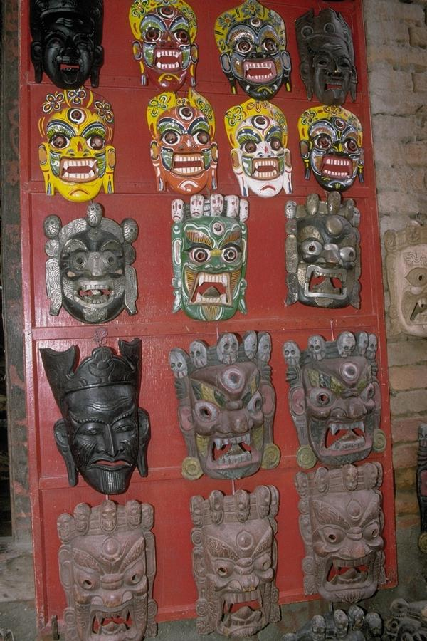
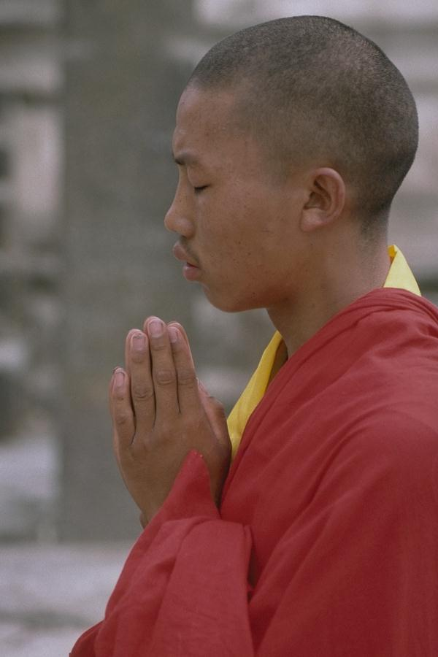

Notes:
Lou: When Adam sinned, he gave away his intimate relationship with God. He gave away his dominion and authority over the earth to Satan.

Slide 39




Notes:
He became a slave to Satan, with the very nature of Satan. He was alienated from God and subject to spiritual death. After his alienation, he had only a carnal mind darkened by sin. His ability was limited only to the extent of his physical strength.

Slide 40


Notes:
He must toil in the frailties of human flesh in the ground that was cursed that brought forth thorns and weeds. In the future, all of his offspring would also be slaves to Satan, alienated from God, and subject to sin and death.

Slide 41

Notes:
Pastor: Man had no authority to free himself from Satan's control. Man had to have more than just forgiveness of sins. Mere forgiveness of sins would still leave man with a nature to sin, a slave to Satan, and with no fellowship with God. Man's union with Satan must be broken. There must be a New Creation of man. Man must receive a new nature, the nature of God.

Slide 42


Notes:
Spiritual death must be absolutely destroyed out of the life of man. The body of sin and death must be eradicated. Man must be delivered from the authority of Satan. Satan must be removed as lord over man, Hebrews 2:14. Man must be delivered from any fear of his old master, Hebrews 2:15.

Slide 43
Legal Grounds
Notes:
Lou: God had to meet man's need for life and restoration of sonship on legal grounds. He is a just God and cannot violate His own nature, Romans 3:26. God must be righteous and just in His dealings both with man and with Satan. Man's sin must not be overlooked. The full penalty must be paid. God must recognize Satan's legal right to rule creation that was given to Satan by Adam, Luke 4:6. He will not steal man back nor force Him from Satan. He must redeem man. He must "buy back" man from Satan on legal grounds.

Slide 44

The Redemption
Only the redemption could free man from alienation from God, from the nature of Satan, and from the penalty of Hell. The redemption is a legal
"buying‑back" of man from slavery to Satan and sin. It must include the full payment of the penalty of Adam's sin, which is death.

Slide 45
The redemption must include deliverance from satanic dominion, that is, give man authority over Satan and his works. It must include a resurrection of man's physical body and immortality, a body over which death can have no further dominion or authority.

Slide 46

The redemption must include a re-creation of mankind, an infilling of God's Nature, so that man may again have perfect fellowship with God. Man must be restored to right relationship to God, to sonship and righteousness, as well as restored to his place as God’s under-ruler over the earth.

Slide 47

The Redeemer
Notes:
The Redeemer
Lou: The Redeemer could not be a natural man. No carnal man could meet the demands of a sinless sacrifice because every natural man was a broken, helpless slave subject to Satan's authority to cast him into Hell at will. No man can stand before God for himself. He is alienated from God and cannot come before His presence.
The Redeemer must come from God. The Redeemer must be a man in order to represent man, but cannot be born of natural generation. The Redeemer must not be a slave to Satan, or under the dominion of spiritual death. He must be greater than Satan. The Redeemer must have the right to stand before God without condemnation. The Redeemer must live a life on earth perfectly pleasing God. The Redeemer must meet Satan's temptations and not yield. The Redeemer must go to Hell in man's behalf and stay there until justice has been fully satisfied. No angel could be the Redeemer because he was not a man. No man could be the Redeemer because he was in union with and subject to Satan.

Slide 48
The Redeemer
Could not be a natural man, yet must be a man in order to represent all men.
Must come from God.
Must be greater than Satan.
Must go to hell for man

Slide 49
The
INCARNATION
Notes:
Pastor: The only answer to man's need of righteousness was the incarnation, God coming in human flesh. Only by paying the full penalty for sin Himself, could a just God have mercy.

Slide 50

A Child Is Born
His Name Is Jesus
Notes:
Lou: "And Joseph also went up from Galilee, out of the city of Nazareth, into Judea, unto the city of David, which is called Bethlehem; (because he was of the house and lineage of David:) to be taxed with Mary his espoused wife, being great with child. And so it was, that, while they were there, the days were accomplished that she should be delivered. And she brought forth her firstborn son, and wrapped him in swaddling clothes, and laid him in a manger, because there was no room in the inn. And there were in the same country shepherds abiding in the field, keeping watch over their flock at night. And, lo, the angel of the Lord came upon them, and glory of the Lord shone round about them: and they were sore afraid. And the angel said unto them, Fear not: for, behold, I bring you good tidings, of great joy, which shall be to all people. For unto you is born this day in the city of David a Savior, which is Christ the Lord. And this shall be a sign unto; Ye shall find the babe wrapped in swaddling clothes, lying in a manger. And suddenly there was with the angel a multitude of the heavenly host praising God, and saying, Glory to God in the highest, and on earth peace, good will toward men." Luke 2:4-14.

Slide 51

"And the Word was made flesh, and dwelt among us, (and we beheld his glory, the glory as of the only begotten of the Father,) full of grace and truth," John 1:14.
Notes:
Pastor: The incarnation was accomplished. "And the Word was made flesh, and dwelt among us, (and we beheld his glory, the glory as of the only begotten of the Father,) full of grace and truth," (John 1:14).
His birth was announced to kings because He is the King of Kings. His birth was announced to shepherds because He is the Chief Shepherd and the Passover Lamb of God who was slain from the foundation of the world.
He that sat upon the circle of the earth, rode upon the wings of the wind, and inhabited eternity, left His throne in glory to come to a manger as a helpless child.

Slide 52

Angels we have heard on high,
Sweetly singing o’er the plains:
And the mountains in reply,
Echoing their joyous strains,
Glo --- --- --- ria in excelsis Deo!
Glo --- --- --- ria in excelsis Deo!
Glo --- --- --- ria in excelsis Deo!

Slide 53
Redeeming love,
A love that knows no limit;
Redeeming love,
A love that shall not die;
My soul shall sing
Throughout the endless ages
With choirs extolling
This great love on high

Slide 54

Jesus is the Messiah,
The Eternal God come to earth
Because He loves you.

Slide 55
Receive His forgiveness and freedom from sin.
Allow Christ to come live in your heart and impart His nature to you.

