Slide 1
The Reason For it All
Louis G. Hulsey
January 17, 2010
Casa Grande, Arizona

Slide 2
Vision and Purpose
No doubt every person has at some time asked the question, “What is it all for?” or “What is the purpose of life?” or “Why did God create me?”
Usually people ask this question in a time of self-doubt or discouragement.
They ask themselves the question, “Is this prize worth all the effort?”
They may be going to school or they may be raising a family.
Vision and purpose are closely related.

Slide 3
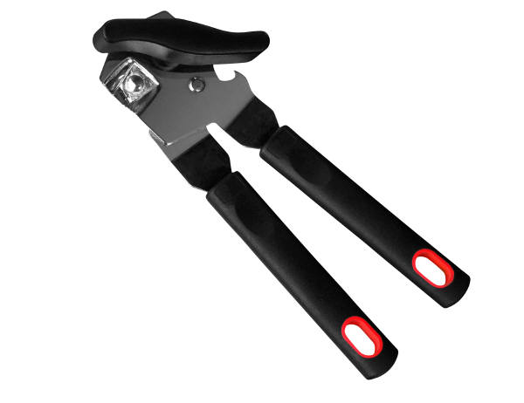
Purpose and Design
The design of every created thing reveals its purpose.
Purpose and design are inseparable.
A can opener is designed to fulfill its purpose.

Slide 4
Purpose and Design
A Watch is Designed To Fulfill its Purpose

Slide 5
Purpose and Design
An eye is designed to fulfill its purpose.

Slide 6
The Design of Man
Genesis 1:26-28, “And God said, Let us make man in our image, after our likeness: and let them have dominion over the fish of the sea, and over the fowl of the air, and over the cattle, and over all the earth, and over every creeping thing that creepeth upon the earth.
27, So God created man in his own image, in the image of God created he him; male and female created he them.
28, And God blessed them, and God said unto them, Be fruitful, and multiply, and replenish the earth, and subdue it: and have dominion over the fish of the sea, and over the fowl of the air, and over every living thing that moveth upon the earth.”

Slide 7
In God’s Image
If man is designed in God’s image, then man must be designed to reflect God’s image.
God’s image in man reflects God’s glory.
The glory is the reflection of God in the face of His saints.

Slide 8
The Ultimate Designer
Design in creation necessitates a Designer.
We see the wisdom of the designer in his creation.
If a designer creates beauty, we can conclude that the designer values beauty.
If the designer creates ugly, we can conclude that he values ugly.
Jesus is the Ultimate Designer.

Slide 9
The Purpose of Man
Revelation 4:11, “Thou art worthy, O Lord, to receive glory and honour and power: for thou hast created all things, and for thy pleasure they are and were created.”
God created mankind to bring Him pleasure.
This is a general purpose for all men.

Slide 10
Individual Purpose
But each individual was created for a distinct purpose.
Esther 4:14, “For if thou altogether holdest thy peace at this time, then shall there enlargement and deliverance arise to the Jews from another place; but thou and thy father's house shall be destroyed: and who knoweth whether thou art come to the kingdom for such a time as this?”

Slide 11
Give God Pleasure
How do we give God the greatest pleasure?
By giving thanks in all things.
By trusting Him and His Word.
By believing God for the impossible. Your faith brings pleasure to God.
By working for goals impossible without Jesus. You obedience brings pleasure to God.
God honors those who honor Him. He blesses His own works.

Slide 12
Life is Not Fair
Life did not seem fair to Joseph. He dreamed great dreams, but they were all dashed to pieces when he was carried away as a slave as a teenager. But by the time he was 30 his dreams had come true.
Joseph was obviously a man of prayer.
He was a man of high moral character.
He was a man who accepted responsibility in spite of his circumstances.
He was faithful to serve at every opportunity.
God used Joseph to save his people from starvation and allowed the infant nation to develop under the protection of Egypt.

Slide 13
Life is Not Fair
Life did not seem fair to Moses.
His parents were slaves.
His mother had to hide him from the Egyptians.
She put him in the river for Pharaoh’s daughter to find.
Although he was trained to be a lawyer in the courts of the king, he had to flee into the desert and became a keeper of sheep.
Although it did not seem fair, God was preparing him for a great mission.

Slide 14
The Benefits are Out of This World
Paul also faced the question of whether the gospel was worth his sacrifices.
I Corinthians 9:10, “…For our sakes, no doubt, this is written: that he that ploweth should plow in hope; and that he that thresheth in hope should be partaker of his hope.”
I Corinthians 9:23-27, “And this I do for the gospel's sake, that I might be partaker thereof with you.
24, Know ye not that they which run in a race run all, but one receiveth the prize? So run, that ye may obtain.
25, And every man that striveth for the mastery is temperate in all things. Now they do it to obtain a corruptible crown; but we an incorruptible.
26, I therefore so run, not as uncertainly; so fight I, not as one that beateth the air: 27, But I keep under my body, and bring it into subjection: lest that by any means, when I have preached to others, I myself should be a castaway.”

