Slide 1
The Firstborn of Creation
Louis G. Hulsey
January 24, 2010
Casa Grande, Arizona

Slide 2
The Image of God
Colossians 1:15-17, “[Jesus] Who is the image [εἰκών, eikōn] of the invisible God, the firstborn [πρωτοτόκος, pro-tot-ok'-os] of every creature: 16, For by him were all things created, that are in heaven, and that are in earth, visible and invisible, whether they be thrones, or dominions, or principalities, or powers: all things were created by him, and for him: 17, And he is before [πρό, pro, “in front of, prior …superior to”] all things, and by him all things consist.”

Slide 3
The Firstborn
Colossians 1:18-19. “And he is the head of the body, the church: who is the beginning, the firstborn [πρωτοτόκος, pro-tot-ok'-os] from the dead; that in all things he might have the preeminence [πρωτεύω, prōteuō]. 19, For it pleased the Father that in him should all fulness [πλήρωμα, plērōma] dwell;”

Slide 4
The Fullness of God
Colossians 2:9, “For in him dwelleth all the fulness of the Godhead bodily [In a human body].”
This is not only His physical body, but His spiritual body, the Church.
John 1:16, “And of his fulness [πλήρωμα, plērōma] have all we received, and grace for grace.”

Slide 5
He is Risen
Ephesians 1:20-21, “Which he [The Heavenly Father] wrought in Christ, when he raised him from the dead, and set him at his own right hand in the heavenly places, 21, Far above all principality, and power, and might, and dominion, and every name that is named, not only in this world, but also in that which is to come:”

Slide 6
He is The Head
Ephesians 1:22-23, “And hath put all things under his feet, and gave him to be the head over all things to [for the benefit of] the church, 23, Which is his body, the fulness [πλήρωμα, plērōma] of him that filleth [πληρόω, plēroō, (From Strong’s Exhaustive Concordance) “to make replete, that is, (literally) to cram (a net), level up (a hollow), or (figuratively) to furnish (or imbue, diffuse, influence), satisfy, execute (an office), finish (a period or task), verify (or coincide with a prediction), etc.: - accomplish, X after, (be) complete, end, expire, fill (up), fulfil, (be, make) full (come), fully preach, perfect, supply.”] all in all.”

Slide 7
He Rules Creation
Matthew Henry comments on Ephesians 1:22-23:
All creatures whatsoever are in subjection to Him;
They must either yield Him sincere obedience or fall under the weight of His scepter, and receive their doom from Him.
God GAVE Him to be head over all things.

Slide 8
Head Over All
It was a gift to Christ, considered as a Mediator, to be advanced to such dominion and headship, and to have such a mystical body prepared for him:
and it was a gift to the church, to be provided with a head endued with so much power and authority.
God gave him to be the head over all things.

Slide 9
Jesus Has All Power
He gave him all power both in heaven and in earth.
The Father loves the Son, and hath given ALL things into his hands [John 3:35].
He is entrusted with all power, that He may dispose of all the affairs of men in subserviency to His designs for His church.

Slide 10
The Lord and His Body
The Lord has founded Zion.
The same power that supports the world supports the church.
We are sure He loves His church, for it is His Body (Eph_1:23), and He will care for it.
It is the fulness of Him that filleth all in all.

Slide 11
The Fullness of God
The fullness of God to the Church is the fullness:
Of revelation
Of knowledge
Of power
Of spiritual understanding
Of intimacy with God
Of material blessings
Of health

Slide 12
The Fullness of God
The fullness of God to the Church is the fullness:
Of love
Of joy
Of peace
Of authority
Of triumph over sin
Of righteousness
Of holiness

Slide 13
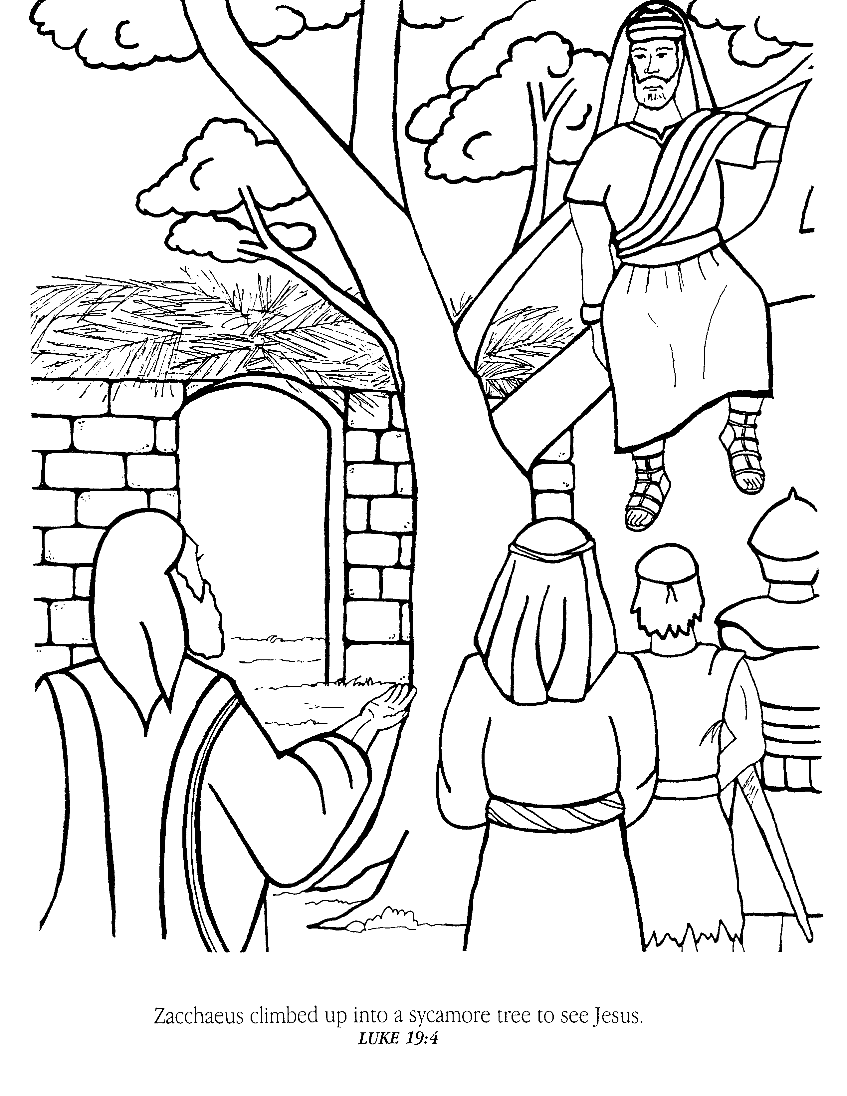
Zacchaeus climbed up into a sycamore tree to see Jesus.
Luke 19:4
Jesus And
Zacchaeus

Slide 14
Jesus and Zacchaeus
Luke 19:2-4, “And, behold, there was a man named Zacchaeus, which was the chief among the publicans, and he was rich. 3, And he sought to see Jesus who he was; and could not for the press, because he was little of stature. 4, And he ran before, and climbed up into a sycomore tree to see him: for he was to pass that way.”

Slide 15
Jesus and Zacchaeus
Luke 19:5-7, “And when Jesus came to the place, he looked up, and saw him, and said unto him, Zacchaeus, make haste, and come down; for to day I must abide at thy house. 6, And he made haste, and came down, and received him joyfully. 7, And when they saw it, they all murmured, saying, That he was gone to be guest with a man that is a sinner.”

Slide 16
Jesus and Zacchaeus
Luke 19:8-10, “And Zacchaeus stood, and said unto the Lord; Behold, Lord, the half of my goods I give to the poor; and if I have taken any thing from any man by false accusation, I restore him fourfold. 9, And Jesus said unto him, This day is salvation come to this house, forsomuch as he also is a son of Abraham. 10, For the Son of man is come to seek and to save that which was lost.”

Slide 17
Jesus and Zacchaeus
Jesus did not invite Zacchaeus to come down from the tree.
Jesus did not ask Zacchaeus if it was convenient for him to have guests that day.
Jesus did not ask Zacchaeus if he had other commitments or priorities.
He COMMANDED Zacchaeus to come down.
Jesus is the πρωτοτόκος, the Firstborn, the Preeminent One, of every creature, the λογος, Eternal Word, the God of the universe, the King of Kings and Lord of Lords.

Slide 18
Jesus and Zacchaeus
If Zacchaeus disobeyed he would have rejected Jesus and become His enemy.
There is no middle ground with Jesus.
Jesus said, “This day is salvation come to this house.” Why, because Zacchaeus was worthy, or because he was a son of Abraham? No, but because he obeyed.
Zacchaeus was saved when he obeyed Jesus and acknowledged Him as Lord.

Slide 19
Jesus and Matthew
Matthew 9:9-11, “And as Jesus passed forth from thence, he saw a man, named Matthew, sitting at the receipt of custom: and he saith unto him, Follow me. And he arose, and followed him. 10, And it came to pass, as Jesus sat at meat in the house, behold, many publicans and sinners came and sat down with him and his disciples. 11, And when the Pharisees saw it, they said unto his disciples, Why eateth your Master with publicans and sinners?”

Slide 20
Jesus and Matthew
Jesus did not excuse Himself for interrupting Matthew’s busy day of work.
Jesus did not ask Matthew if he would like to follow Him.
Jesus did not ask Matthew if it was convenient for him to follow Jesus.
Jesus COMMNADED Matthew to follow him.

Slide 21
Man-Centered Gospel
The Church today preaches a man-centered gospel.
They ask people if they will “Accept Jesus.” That is man-centered.
The question is whether or not He will accept you.
Jesus COMMANDED all men to repent. It is not a suggestion. It is a command.

Slide 22
Peter’s Sermon
Acts 2:14 – 39.
Peter said, “This is that,” (v. 16).
“Him…ye have taken and…crucified and slain,” (v. 23).
“Whom God hath raised up,” (v. 24).
David prophesied His death and resurrection, (25-31).
“God hath made that same Jesus, whom ye have crucified, both Lord and Christ,” (v. 36).

Slide 23
Peter’s Sermon
Acts 2:37-38, “Now when they heard this, they were pricked in their heart, and said unto Peter and to the rest of the apostles, Men and brethren, what shall we do? 38, Then Peter said unto them, Repent, and be baptized every one of you in the name of Jesus Christ for the remission of sins, and ye shall receive the gift of the Holy Ghost.”

Slide 24
Jesus is Lord
We are not saved because we agree to a certain doctrine or join a certain church.
We are saved when we acknowledge the lordship of Jesus and choose to follow Him.
He has given the command to repent from sin and follow Him.
Will you obey?

