Slide 1
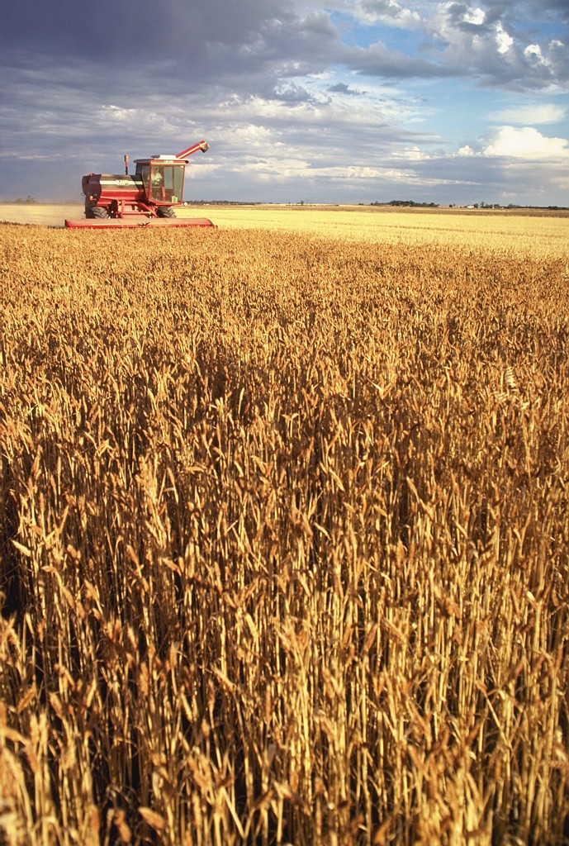
The Feasts of Israel
Louis G. Hulsey
September 9, 2012
Casa Grande, Arizona

Slide 2
Three Convocations
All male adults appeared before God at the temple three times a year.
The first convocation included:
Passover – repentance, sacrifice, forgiveness of sins (communion)
Unleavened Bread – cleansing, sanctification, and purity (baptism)
Firstfruits – thanksgiving, praise, new life, fruits of new birth (fruit-bearing)

Slide 3
Three Convocations
Deuteronomy 16:16, KJV, “Three times in a year shall all thy males appear before the LORD thy God in the place which he shall choose; in the feast of unleavened bread, and in the feast of weeks, and in the feast of tabernacles: and they shall not appear before the LORD empty:”

Slide 4
The Calendar
The days of the Jewish calendar began in the evening, “and the evening and morning were the first day,” Genesis 1:5.
Jesus was crucified on Wednesday the day before Passover, a High Sabbath.

Slide 5
The Calendar
Mark 15:42-43, KJV, “And now when the even was come, because it was the preparation, that is, the day before the sabbath, 43, Joseph of Arimathaea, an honourable counsellor, which also waited for the kingdom of God, came, and went in boldly unto Pilate, and craved the body of Jesus.”

Slide 6
The Calendar
Jesus lay in the grave through Passover, and Unleavened Bread, and arose on Firstfruits, the first day of the week.
Mark 16:2, KJV, “And very early in the morning the first day of the week, they came unto the sepulchre at the rising of the sun.”

Slide 7
Passover (Pesach)
Exodus 12:1-3, KJV
1, “And the LORD spake unto Moses and Aaron in the land of Egypt, saying,
2, “This month shall be unto you the beginning of months: it shall be the first month of the year to you.”
3, “Speak ye unto all the congregation of Israel, saying, In the tenth day of this month they shall take to them every man a lamb, according to the house of their fathers, a lamb for an house:”

Slide 8
Passover (Pesach)
Exodus 12:4-5, KJV
4, “And if the household be too little for the lamb, let him and his neighbour next unto his house take it according to the number of the souls; every man according to his eating shall make your count for the lamb.”
5, “Your lamb shall be without blemish, a male of the first year: ye shall take it out from the sheep, or from the goats:”

Slide 9
Passover (Pesach)
Exodus 12:6-8, KJV
6, “And ye shall keep it up until the fourteenth day of the same month: and the whole assembly of the congregation of Israel shall kill it in the evening.”
7, “And they shall take of the blood, and strike it on the two side posts and on the upper door post of the houses, wherein they shall eat it.”
8, “And they shall eat the flesh in that night, roast with fire, and unleavened bread; and with bitter herbs they shall eat it.”

Slide 10
Passover (Pesach)
Exodus 12:9-10, KJV
9, “Eat not of it raw, nor sodden at all with water, but roast with fire; his head with his legs, and with the purtenance thereof.”
10, “And ye shall let nothing of it remain until the morning; and that which remaineth of it until the morning ye shall burn with fire.”

Slide 11
Passover (Pesach)
Exodus 12:11-12, KJV
11, “And thus shall ye eat it; with your loins girded, your shoes on your feet, and your staff in your hand; and ye shall eat it in haste: it is the LORD'S passover.
12, “For I will pass through the land of Egypt this night, and will smite all the firstborn in the land of Egypt, both man and beast; and against all the gods of Egypt I will execute judgment: I am the LORD.

Slide 12
Passover (Pesach)
Exodus 12:13-14, KJV
13, “And the blood shall be to you for a token upon the houses where ye are: and when I see the blood, I will pass over you, and the plague shall not be upon you to destroy you, when I smite the land of Egypt.
14, “And this day shall be unto you for a memorial; and ye shall keep it a feast to the LORD throughout your generations; ye shall keep it a feast by an ordinance for ever.”

Slide 13
Passover (Pesach)
Exodus 12:26-27, KJV
26, “And it shall come to pass, when your children shall say unto you, What mean ye by this service?”
27, “That ye shall say, It is the sacrifice of the LORD'S passover, who passed over the houses of the children of Israel in Egypt, when he smote the Egyptians, and delivered our houses. And the people bowed the head and worshipped.”

Slide 14
Passover (Pesach)
Exodus 12:26-27, KJV
28, “And the children of Israel went away, and did as the LORD had commanded Moses and Aaron, so did they.”
29, “And it came to pass, that at midnight the LORD smote all the firstborn in the land of Egypt, from the firstborn of Pharaoh that sat on his throne unto the firstborn of the captive that was in the dungeon; and all the firstborn of cattle.”

Slide 15
The Lamb
The lamb was to be roasted, not boiled or stewed. There was to be enough for everyone. It was to be completely consumed as a sacrifice.
The blood was applied to the door with hyssop, Exodus 12:22.
The bitter herbs (verse 8) spoke of the bondage of the past.
The unleavened bread spoke of the holiness of the future.

Slide 16
The Lamb
The lamb signified a horrible calamity to the sinners of Egypt.
The lamb spoke of judgment and death to those who did not receive it.
The lamb died for the firstborn in every household.
The blood of the lamb was required to redeem the life of the firstborn of every family, Exodus 13:13, 15; 34:20, Numbers 18:15.
But the lamb was deliverance to God’s covenant people.

Slide 17
Jesus the Lamb
Jesus is the Lamb of God, John 1:36.
He was betrayed and sold for the price of a Passover lamb on the 10th day of Abib (Nissan).
He was crucified at the very hour when the Passover lambs were killed.

Slide 18
Jesus the Lamb
Millions of lambs had died at Passover for the sins of Israel, but on the day of the crucifixion the True Lamb was sacrificed.
Jesus arose on the first day of the week, the Feast of Firstfruits, Leviticus 23:11.

Slide 19
Feast of Unleavened Bread
Hag HaMatzah
Exodus 12:15-16, KJV
15, “Seven days shall ye eat unleavened bread; even the first day ye shall put away leaven out of your houses: for whosoever eateth leavened bread from the first day until the seventh day, that soul shall be cut off from Israel.”
16, “And in the first day there shall be an holy convocation, and in the seventh day there shall be an holy convocation to you; no manner of work shall be done in them, save that which every man must eat, that only may be done of you.”

Slide 20
Unleavened Bread
Exodus 12:17-18, KJV
17, “And ye shall observe the feast of unleavened bread; for in this selfsame day have I brought your armies out of the land of Egypt: therefore shall ye observe this day in your generations by an ordinance for ever.”
18, “In the first month, on the fourteenth day of the month at even, ye shall eat unleavened bread, until the one and twentieth day of the month at even.”

Slide 21
Unleavened Bread
Exodus 12:19-20, KJV
19, “Seven days shall there be no leaven found in your houses: for whosoever eateth that which is leavened, even that soul shall be cut off from the congregation of Israel, whether he be a stranger, or born in the land.”
20, “Ye shall eat nothing leavened; in all your habitations shall ye eat unleavened bread.”

Slide 22
Unleavened Bread
Unleavened bread was eaten from the 14th to the 21st day of Abib. See Leviticus 23:4-8.
The feast began the evening of the day of Passover and lasted 7 days.
This feast symbolized separation from leaven, that is, separation from Egypt, bondage, and death. Leaven is a type of sin and bondage.
The Israelites were commanded to do no work on the Sabbath.
Unleavened bread is parallel with water baptism and sanctification in the New Testament Church.

Slide 23
Unleavened Bread
All leaven was to be removed from every house.
If even a trace of leaven was found in any house of Israel, that house was to be cut off from the nation, removed from citizenship and fellowship with Israel.
Leaven is a type of wickedness. When God delivers us from Egypt’s bondage of sin we are to put away from us every hint of sin. It is not acceptable to retain any hint of sin or disobedience.

Slide 24
Unleavened Bread
The separation of leaven is the separation of Egypt from Israel.
You can take the sinner out of the world, but God must take the world out of the sinner.
Water baptism is a type of the washing away of our sins.
Every day for one week the priests offered two bullocks, one ram, and seven lambs, Leviticus 23:7, 8; Numbers 28:17-19.

Slide 25
Jesus and Unleavened Bread
The critics of Jesus taunted Him. John 6:31. KJV, “Our fathers did eat manna [μάννα] in the desert; as it is written, He gave them bread from heaven [ἄρτον (unleavened bread) ἐκ τοῦ οὐρανοῦ] to eat.”
Jesus used unleavened bread to celebrate the Passover.
Matthew 26:26, KJV, “And as they were eating, Jesus took bread [ἄρτον], and blessed it, and brake it, and gave it to the disciples, and said, Take, eat; this is my body.”

Slide 26
Jesus is the Unleavened Bread
Unleavened bread is a type of Christ. If leaven represents sin, Jesus is the bread without sin. Jesus came from the Father without sin.
If Jesus had sinned, He would have had to die for His own sins, but would have had no authority to overcome Satan and death.
There is no leaven of sin in Jesus.
When He is finished with His Church there will be no leaven in it either.

Slide 27
Christ is the Unleavened Bread
We are now His body – without leaven.
The Jews knew that leaven signified sin.
John 6:35, KJV, “And Jesus said unto them, I am the bread of life: he that cometh to me shall never hunger; and he that believeth on me shall never thirst.”

Slide 28
The Eternal Bread
John 6:48-58 KJV
48, “I am that bread of life.” [ἐγώ εἰμι ὁ ἄρτος (unleavened bread) τῆς ζωῆς.
49, “Your fathers did eat manna in the wilderness, and are dead.”
50, “This is the bread which cometh down from heaven, that a man may eat thereof, and not die.”

Slide 29
The Eternal Bread
John 6:51-52, KJV
51, “I am the living bread which came down from heaven: if any man eat of this bread, he shall live for ever: and the bread that I will give is my flesh, which I will give for the life of the world.”
52, “The Jews therefore strove among themselves, saying, How can this man give us his flesh to eat?”

Slide 30
The Eternal Bread
John 6:53-55, KJV
53, “Then Jesus said unto them, Verily, verily, I say unto you, Except ye eat the flesh of the Son of man, and drink his blood, ye have no life in you.”
54, “Whoso eateth my flesh, and drinketh my blood, hath eternal life; and I will raise him up at the last day.”
55, “For my flesh is meat indeed, and my blood is drink indeed.”

Slide 31
The Eternal Bread
John 6:56-58, KJV
56, “He that eateth my flesh, and drinketh my blood, dwelleth in me, and I in him.”
57, “As the living Father hath sent me, and I live by the Father: so he that eateth me, even he shall live by me.”
58, “This is that bread which came down from heaven: not as your fathers did eat manna, and are dead: he that eateth of this bread shall live for ever.”

Slide 32
Feast of Firstfruits
Hag ha‐Bikkurim
The Passover, Unleavened Bread, and the Feast of Firstfruits represent the death, burial, and resurrection of Christ, as well as the believer.
Leviticus 23:10, KJV
10, “Speak unto the children of Israel, and say unto them, When ye be come into the land which I give unto you, and shall reap the harvest thereof, then ye shall bring a sheaf of the firstfruits of your harvest unto the priest:”

Slide 33
Firstfruits
Leviticus 23:11-12, KJV
11, “And he shall wave the sheaf before the LORD, to be accepted for you: on the morrow after the sabbath the priest shall wave it.”
12, “And ye shall offer that day when ye wave the sheaf an he lamb without blemish of the first year for a burnt offering unto the LORD.”

Slide 34
Firstfruits
Leviticus 23:13-14, KJV
13, “And the meat offering thereof shall be two tenth deals of fine flour mingled with oil, an offering made by fire unto the LORD for a sweet savour: and the drink offering thereof shall be of wine, the fourth part of an hin.”
14, “And ye shall eat neither bread, nor parched corn, nor green ears, until the selfsame day that ye have brought an offering unto your God: it shall be a statute for ever throughout your generations in all your dwellings.”

Slide 35
Firstfruits
The firstfruits offering was a sheaf of barley waved unto the Lord.
The Feast of Firstfruits came “on the morrow after the Sabbath.”
Leviticus 23:11, KJV, “And he shall wave the sheaf before the LORD, to be accepted for you: on the morrow after the sabbath the priest shall wave it.”

Slide 36
Firstfruits
The first harvest in spring was barley.
The sheaf of barley was brought immediately to the priest as soon as the harvest began.
The people were not to eat of the harvest nor eat anything that day until the firstfruits had been offered to the Lord.
The firstfruits came before the tithe which followed as reaping progressed.
When the Lord accepted the firstfruits it meant that He had accepted and sanctified the entire harvest to come.

Slide 37
Barley
Barley is sown in October and November after the early rain. Its harvest began about the 16th day of Abib.
Barley was animal food, especially for horses, mules, and donkeys.
It was used for bread only by the very poor, II Kings 4:42.
A barley cake demonstrated Gideon’s poverty, Judges 7:13.
It was the jealousy offering, Numbers 5:15.
It was part of the price of an adulteress. Hosea paid 15 pieces of silver and 7½ pints of barley for Gomer.
A handful of barley was the price of a prostitute, Ezekiel 13:19.

Slide 38
Jesus is the Firstfruits
A. Jesus is the “first-born” of every creature. That is, He is the heir of all things.
Romans 8:29, KJV, “For whom he did foreknow, he also did predestinate to be conformed to the image of his Son, that he might be the firstborn among many brethren.”
“Firstborn” does not mean that the Logos was birthed or created by the Heavenly Father at some time, but that He eternally existed as the source and purpose of all creation.

Slide 39
Jesus is the Firstfruits
Colossians 1:15-17, KJV
15, “Who is the image of the invisible God, the firstborn of every creature:”
16, “For by him were all things created, that are in heaven, and that are in earth, visible and invisible, whether they be thrones, or dominions, or principalities, or powers: all things were created by him, and for him:”
17, “And he is before all things, and by him all things consist.”

Slide 40
Jesus is the Firstfruits
Colossians 1:18-19, KJV
18, “And he is the head of the body, the church: who is the beginning, the firstborn from the dead; that in all things he might have the preeminence.”
19, “For it pleased the Father that in him should all fulness dwell;”

Slide 41
Jesus is the Firstfruits
Hebrews 1:6, KJV, “And again, when he bringeth in the firstbegotten [πρωτότοκον = preeminent one] into the world, he saith, And let all the angels of God worship him.”

Slide 42
The Firstfruits
Like Jesus, we are the Church of the Firstborn.
Hebrews 12:22-23, KJV
22, “But ye are come unto mount Sion, and unto the city of the living God, the heavenly Jerusalem, and to an innumerable company of angels,”
23, “To the general assembly and church of the firstborn [heirs to a kingdom, a royal family.], which are written in heaven, and to God the Judge of all, and to the spirits of just men made perfect,”

Slide 43
The Firstfruits
B. Jesus is the “Firstfruits of them that slept.”
1 Corinthians 15:20-21, KJV
20, “But now is Christ risen from the dead, and become the firstfruits of them that slept.”
21, “For since by man came death, by man came also the resurrection of the dead.”

Slide 44
The Firstfruits
1 Corinthians 15:22-23, KJV
22, “For as in Adam all die, even so in Christ shall all be made alive.”
23, “But every man in his own order: Christ the firstfruits; afterward they that are Christ's at his coming.”

Slide 45
Firstfruits
Revelation 1:5-6, KJV
5, “And from Jesus Christ, who is the faithful witness, and the first begotten of the dead, and the prince of the kings of the earth. Unto him that loved us, and washed us from our sins in his own blood,”
6, “And hath made us kings and priests unto God and his Father; to him be glory and dominion for ever and ever. Amen.”

Slide 46
Firstfruits
By death, judgment, and resurrection God is re-creating and renewing the earth from the curse of sin.
By this means there will be a “new heaven and a new earth,” Revelation 21:1.
Jesus said, “Verily, verily, I say unto you, Except a corn of wheat fall into the ground and die, it abideth alone: but if it die, it bringeth forth much fruit,” John 12:24 KJV.

Slide 47
Firstfruits
C. Because Christ has been accepted as the firstfruits, we too are completely accepted in Christ.
Romans 11:16, KJV, “For if the firstfruit be holy, the lump is also holy: and if the root be holy, so are the branches.”
Ephesians 1:6, KJV, “To the praise of the glory of his grace, wherein he hath made us accepted in the beloved.”
We are identified with Christ and are one with Him.
Jesus is the standard and foundation of the Church.

Slide 48
Firstfruits
II. We offer the firstfruits of our spirit to God.
When we come to Christ we are:
Delivered from bondage by the Lamb (Passover)
Cleansed from sin, separated from the world (Unleavened Bread)
Filled with the Holy Spirit and given unto God (Firstfruits).

Slide 49
Firstfruits
The Feasts of Israel represent the spiritual life of the believer.
Passover = deliverance from sin.
Unleavened Bread = purging from sin.
Firstfruits = resurrection to new life.
Water baptism is an outward sign of this process described in Romans 6.

Slide 50
Firstfruits
A. No one was born again until the Firstfruits arose from the dead. No one could be born again until the full penalty of sin had been paid.
Salvation is a process: spirit, soul, and body.
My spirit is re-created by His Holy Spirit at the new birth.
The soulish man and the body have to die, each in order, to bring forth the new creation, Psalm 25:1.

Slide 51
Firstfruits
The carnal man is crucified to bring to birth the Spirit-ruled man.
At the new birth our spirit is raised to sit with Christ in heavenly places. The Spirit of God and the spirit of man become one.
To be ruled by the Spirit comes only at the death of the carnal nature, Galatians 2:20.
Now, as believers, we are experiencing the harvesting of the soulish man.
Soon we will experience the harvest of the body as well.

