Slide 1
Take Up Your Bed
Louis G. Hulsey
October 14, 2012
Casa Grande, Arizona

Slide 3
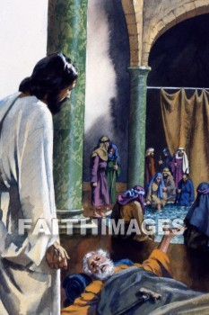
John 5:1-2
1, “After this there was a feast of the Jews; and Jesus went up to Jerusalem.”
2, “Now there is at Jerusalem by the sheep market a pool, which is called in the Hebrew tongue Bethesda, having five porches.”

Slide 4
John 5:3-4
3, “In these lay a great multitude of impotent folk, of blind, halt, withered, waiting for the moving of the water.”
4, “For an angel went down at a certain season into the pool, and troubled the water: whosoever then first after the troubling of the water stepped in was made whole of whatsoever disease he had.”

Slide 5
John 5:5-6
5, “And a certain man was there, which had an infirmity thirty and eight years.”
6, “When Jesus saw him lie, and knew that he had been now a long time in that case, he saith unto him, Wilt thou be made whole?”

Slide 6
John 5:7-9
7, “The impotent man answered him, Sir, I have no man, when the water is troubled, to put me into the pool: but while I am coming, another steppeth down before me.”
8, “Jesus saith unto him, Rise, take up thy bed, and walk.”
9, “And immediately the man was made whole, and took up his bed, and walked: and on the same day was the sabbath.”

Slide 7
Receive the Promise
This man had been at the Pool of Bethesda thirty-eight years.
He must have strongly believed that he would have been healed if he could get in after the troubling of the waters.
Jesus gave him a formula for healing. “Rise, take up thy bed, and walk.”

Slide 8
The Formula?
Was it the formula that healed the man?
Would he have been healed if he had tried to do this before Jesus came?
He had probably tried to do it many times.

Slide 9
Jesus is the Healer
The difference this time was that Jesus had come.
The man believed in Jesus and obeyed.
It was not the formula that healed him but his faith in Jesus.
We don’t just have faith in faith or faith in some magic formula.
We have faith in Jesus, the healer.

Slide 10
Does Faith Meet Your Need?
Jesus said to the woman with the issue of blood, “Daughter, thy faith hath made thee whole; go in peace, and be whole of thy plague,” Mark 5:34.
Jesus said to Blind Bartimaeus, “Go thy way; thy faith hath made thee whole. And immediately he received his sight, and followed Jesus in the way,” Mark 10:52.

Slide 11
Have Faith of God
Jesus said to the Samaritan leper, “Arise, go thy way: thy faith hath made thee whole,” Luke 17:19.
Jesus told all these people that their faith had made them whole, but it was faith in Jesus, not just faith in a formula.

Slide 12
Four Lepers
The Syrians had surrounded the city of Samaria and cut off food and water from the city.
2 Kings 7:3, KJV, “And there were four leprous men at the entering in of the gate: and they said one to another, Why sit we here until we die?”
The four lepers arose up and trusted the Lord for provision, and the Lord intervened.

Slide 13
II Kings 7:4-5
4, “If we say, We will enter into the city, then the famine is in the city, and we shall die there: and if we sit still here, we die also. Now therefore come, and let us fall unto the host of the Syrians: if they save us alive, we shall live; and if they kill us, we shall but die.”
5, “And they rose up in the twilight, to go unto the camp of the Syrians: and when they were come to the uttermost part of the camp of Syria, behold, there was no man there.”

Slide 14
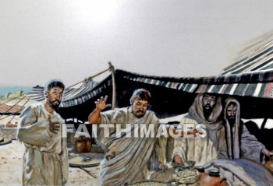
6, “For the Lord had made the host of the Syrians to hear a noise of chariots, and a noise of horses, even the noise of a great host: and they said one to another, Lo, the king of Israel hath hired against us the kings of the Hittites, and the kings of the Egyptians, to come upon us.”

Slide 15
7, “Wherefore they arose and fled in the twilight, and left their tents, and their horses, and their asses, even the camp as it was, and fled for their life.”
8, “And when these lepers came to the uttermost part of the camp, they went into one tent, and did eat and drink, and carried thence silver, and gold, and raiment, and went and hid it; and came again, and entered into another tent, and carried thence also, and went and hid it.”

Slide 16
Let’s Believe God
How long have you been sitting in your situation waiting for something to change?
Your situation may not change until you decide to change it.
Trust in the Lord Jesus like the man at the Pool of Bethesda.
Arise, take up your bed and walk.

Slide 17
God is Faithful
God is with you. He is faithful. He is a “rewarder of them that diligently seek Him,” Hebrews 11:6.
He loves to see your faith. He will lead you. He will help you.
He may remove the obstacles before you even if he has to use hornets.
Exodus 23:28. “And I will send hornets before thee, which shall drive out the Hivite, the Canaanite, and the Hittite, from before thee.”

Slide 18
God is Faithful
Pray. See the need. Believe God to help you fill it.
Jesus turned water into wine.
What is the greatest need you have?
Trust the Lord.
Count your resources.
Invest what you have and believe God to use the resources you have to bless you.

Slide 19
God is Faithful
A widow woman had no food and a creditor was coming to take her sons into slavery.
The prophet Elisha asked her what resources she had. She only had a pot of oil.
Elisha told her to go borrow vessels from her neighbors.
The Lord multiplied the oil. She paid the debt and had enough money to support herself, II Kings 4.

