Slide 1
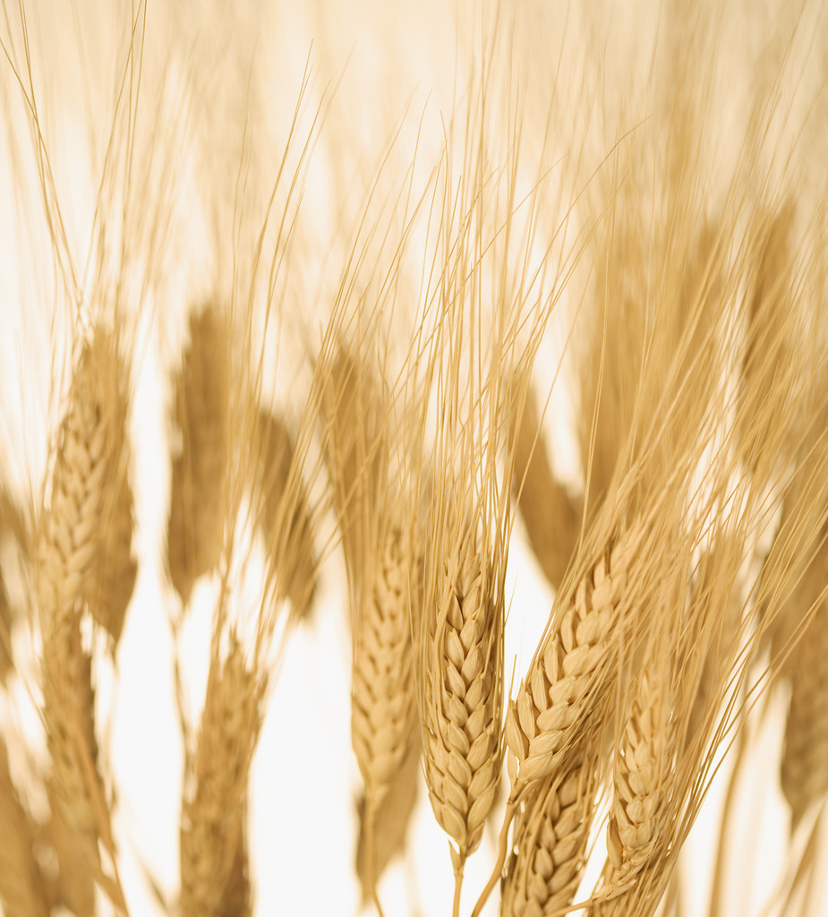
The Outpouring at Pentecost
Louis G. Hulsey
May 27, 2012
Casa Grande, Arizona

Slide 2
Acts 2:1-3
1, “And when the day of Pentecost was fully come, they were all with one accord in one place.
2, And suddenly there came a sound from heaven as of a rushing mighty wind, and it filled all the house where they were sitting.
3, And there appeared unto them cloven tongues like as of fire, and it sat upon each of them.

Slide 3
Acts 2:4-6
4, And they were all filled with the Holy Ghost, and began to speak with other tongues, as the Spirit gave them utterance.
5, And there were dwelling at Jerusalem Jews, devout men, out of every nation under heaven.
6, Now when this was noised abroad, the multitude came together, and were confounded, because that every man heard them speak in his own language.

Slide 4
Acts 2:7-9
7, And they were all amazed and marvelled, saying one to another, Behold, are not all these which speak Galilaeans?
8, And how hear we every man in our own tongue, wherein we were born?
9, Parthians, and Medes, and Elamites, and the dwellers in Mesopotamia, and in Judaea, and Cappadocia, in Pontus, and Asia,

Slide 5
Acts 2:10-12
10, Phrygia, and Pamphylia, in Egypt, and in the parts of Libya about Cyrene, and strangers of Rome, Jews and proselytes,
11, Cretes and Arabians, we do hear them speak in our tongues the wonderful works of God.
12, And they were all amazed, and were in doubt, saying one to another, What meaneth this?

Slide 6
Acts 2:13-15
13, Others mocking said, These men are full of new wine.
14, But Peter, standing up with the eleven, lifted up his voice, and said unto them, Ye men of Judaea, and all ye that dwell at Jerusalem, be this known unto you, and hearken to my words:
15, For these are not drunken, as ye suppose, seeing it is but the third hour of the day.

Slide 7
Acts 2:16-17
16, But this is that which was spoken by the prophet Joel;
17, And it shall come to pass in the last days, saith God, I will pour out of my Spirit upon all flesh: and your sons and your daughters shall prophesy, and your young men shall see visions, and your old men shall dream dreams:”

Slide 8
Acts 2:41
Acts 2:41, “Then they that gladly received his word were baptized: and the same day there were added unto them about three thousand souls.”

Slide 9
Pentecost and Shavuot
Pentecost did not begin on the birthday of the Church.
Pentecost was one of the seven feasts kept by Israel every year.
Pentecost was 50 days after the Feast of First Fruits. It always came on Sunday.
Pentecost is Greek and means “fifty,” commemorating 50 days.
In Hebrew it is called Shavuot.

Slide 10
Shavuot
The ancient rabbis reasoned that if Passover commemorated the Exodus, then Shavuot commemorated the establishment of the Covenant on Mt. Sinai 50 days later.
Every year the Jews would read Exodus 19 & 20 to celebrate Shavuot.

Slide 11
Exodus 19:16-17
16, “And it came to pass on the third day in the morning, that there were thunders and lightnings, and a thick cloud upon the mount, and the voice of the trumpet exceeding loud; so that all the people that was in the camp trembled.
17, And Moses brought forth the people out of the camp to meet with God; and they stood at the nether part of the mount.

Slide 12
Exodus 19:18-20
18, And mount Sinai was altogether on a smoke, because the LORD descended upon it in fire: and the smoke thereof ascended as the smoke of a furnace, and the whole mount quaked greatly.
19, And when the voice of the trumpet sounded long, and waxed louder and louder, Moses spake, and God answered him by a voice.
20, And the LORD came down upon mount Sinai, on the top of the mount: and the LORD called Moses up to the top of the mount; and Moses went up.”

Slide 13
God Gave Ten Commandments
Exodus 20:18-21
18, “And all the people saw the thunderings, and the lightnings, and the noise of the trumpet, and the mountain smoking: and when the people saw it, they removed, and stood afar off.
19, And they said unto Moses, Speak thou with us, and we will hear: but let not God speak with us, lest we die.

Slide 14
Exodus 20:20-21
20, And Moses said unto the people, Fear not: for God is come to prove you, and that his fear may be before your faces, that ye sin not.
21, And the people stood afar off, and Moses drew near unto the thick darkness where God was.”

Slide 15
Similarities Between the Day of the Covenant and Pentecost
The Day of Pentecost was similar to the day the Law was given.
The Day of the Covenant came with fire and lightening.
Pentecost came with fire and wind.
The Day of the Covenant established the law and authority for the nation of Israel.
The Day of Pentecost established the power and authority of the Church.

Slide 16
Similarities Between the Day of the Covenant and Pentecost
The Old Covenant was written on tablets of stone.
The New Covenant was written on the hearts of men.
Jeremiah 31:31-34
31, “Behold, the days come, saith the LORD, that I will make a new covenant with the house of Israel, and with the house of Judah:

Slide 17
Jeremiah 31:32-33
32, Not according to the covenant that I made with their fathers in the day that I took them by the hand to bring them out of the land of Egypt; which my covenant they brake, although I was an husband unto them, saith the LORD:
33, But this shall be the covenant that I will make with the house of Israel; After those days, saith the LORD, I will put my law in their inward parts, and write it in their hearts; and will be their God, and they shall be my people.

Slide 18
Jeremiah 31:34
34, And they shall teach no more every man his neighbour, and every man his brother, saying, Know the LORD: for they shall all know me, from the least of them unto the greatest of them, saith the LORD: for I will forgive their iniquity, and I will remember their sin no more.”

Slide 19
The Torah and Pentecost
In “The Deeper Meaning of Pentecost,” p.22 of Jewish Voice Today, May/June 2012, Ann Spangler and Lois Tverberg wrote,
“Like the Torah, the Spirit reveals God’s truth, instructs us, and convicts us of sin. But unlike the Torah, the Spirit empowers us to live in communion with God by changing our hearts from within, something that the law could not do (Romans 8:5-7).”

Slide 20
The New Temple
Old Covenant worship was centered in a temple of stone.
New Covenant worship is centered in hearts of flesh.
We are the new temple.
1 Corinthians 3:16, “Know ye not that ye are the temple of God, and that the Spirit of God dwelleth in you?”

Slide 21
Pentecost or Shavuot
First Fruits celebrated the beginning of the barley harvest.
Shavuot represented the beginning of the wheat harvest: which represents the beginning of the harvest of souls into the Body of Christ.

Slide 22
Events of Pentecost
The people began praying in the upper room.
Acts 1:13, “And when they were come in, they went up into an upper room, where abode both Peter, and James, and John, and Andrew, Philip, and Thomas, Bartholomew, and Matthew, James the son of Alphaeus, and Simon Zelotes, and Judas the brother of James.”

Slide 23
Events of Pentecost
Acts 1:15, “And in those days Peter stood up in the midst of the disciples, and said, (the number of names together were about an hundred and twenty,)”
After that the Holy Ghost began to fall the people went to the temple before 9:00 AM because it was Pentecost. There they encountered all different kinds of Jews who spoke different languages.

Slide 24
Events of Pentecost
The temple was the only place large enough to accommodate 3,000 people.
Right outside the temple there were 300 ceremonial baths, enough to baptize 3,000 people.
The ruins of them are still there to this day.

Slide 25
Pentecost and the Temple
Pentecost is parallel to the dedication of the temple of Solomon
There were 120 priests and 120 in the upper room.
The Shekinah came into the temple and at Pentecost came into the believers.

Slide 26
II Chronicles 5:13-14
13, “It came even to pass, as the trumpeters and singers were as one, to make one sound to be heard in praising and thanking the LORD; and when they lifted up their voice with the trumpets and cymbals and instruments of musick, and praised the LORD, saying, For he is good; for his mercy endureth for ever: that then the house was filled with a cloud, even the house of the LORD;
14, So that the priests could not stand to minister by reason of the cloud: for the glory of the LORD had filled the house of God.”

Slide 27
Baptism of the Spirit
The baptism of the Holy Spirit is for you.
Luke 11:11-13 “If a son shall ask bread of any of you that is a father, will he give him a stone? or if he ask a fish, will he for a fish give him a serpent? 12, Or if he shall ask an egg, will he offer him a scorpion? 13, If ye then, being evil, know how to give good gifts unto your children: how much more shall your heavenly Father give the Holy Spirit to them that ask him?”

Slide 28
The Anointing
The baptism of the Holy Spirit is Christ’s anointing of authority. Prophets, priests, and kings were anointed as a sign of God’s authority and power given to them.
The infilling of the Holy Spirit is the earnest of our inheritance in heaven.
2 Corinthians 1:22, “[God]Who hath also sealed us, and given the earnest of the Spirit in our hearts.”

Slide 29
Baptism of the Spirit
The baptism of the Holy Spirit is infilling of the power of God to perform His works His way.
The baptism of the Holy Spirit is the infilling of the Comforter, the paraclete, who pleads our case in the court of heaven.
John 16:8, “And when he [the Comforter] is come, he will reprove [ἐλέγχω = convict, convince] the world of [about what is] sin, and of righteousness, and of judgment:”

Slide 30
John 16:8
^{Amplified Version:} ^{John 16:8 “}And when He comes, He will convict and convince the world and bring demonstration to it about sin and about righteousness (uprightness of heart and right standing with God) and about judgment:”

Slide 31
The Spirit Leads
The Holy Spirit teaches us and leads us.
^{John 16:13, AMP, “}But when He, the Spirit of Truth (the Truth-giving Spirit) comes, He will guide you into all the Truth (the whole, full Truth). For He will not speak His own message [on His own authority]; but He will tell whatever He hears [from the Father; He will give the message that has been given to Him], and He will announce and declare to you the things that are to come [that will happen in the future].”

Slide 32
The Spirit Intercedes
Romans 8: 26-27, AMP
^{26 “}So too the [Holy] Spirit comes to our aid and bears us up in our weakness; for we do not know what prayer to offer nor how to offer it worthily as we ought, but the Spirit Himself goes to meet our supplication and pleads in our behalf with unspeakable yearnings and groanings too deep for utterance.
²⁷ And He Who searches the hearts of men knows what is in the mind of the [Holy] Spirit [what His intent is], because the Spirit intercedes and pleads [before God] in behalf of the saints according to and in harmony with God’s will.”

Slide 33
Receive the Power
Praying “in the Spirit” is like a river of life that empowers, restores, and refreshes.
The Holy Spirit brings gifts and fruit.

Slide 34
Receive the Holy Spirit
Receive the power of the Holy Spirit.
I saw the Church like broken branches and twigs trampled on the ground, cut off from the vine. The fire was ready to devour them. But revival of the Holy Ghost shall be like a river of life unto those dead branches upon the ground. As Aaron’s rod budded and blossomed, so shall those who receive the living waters of the Holy Ghost.

