Slide 1
Marriage Customs of Israel
Louis G. Hulsey
September 2, 2012
Casa Grande, Arizona

Slide 2
Marriage Customs of Israel
Betrothal
The first major step in a Jewish marriage was betrothal.
The prospective groom and usually his father would go to the home of the bride.

Slide 4
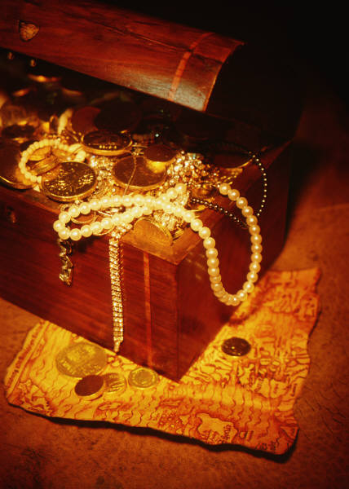
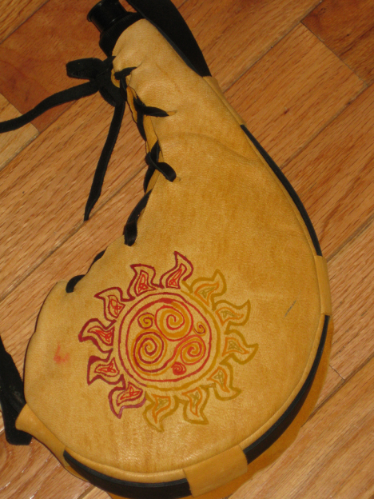
Marriage Customs of Israel
The prospective groom took with him the dowry, the betrothal contract, and a skin of wine.

Slide 5
The Marriage Covenant
The father of the groom may negotiate the marriage as Samson’s father did, or his father’s agent as when Abraham sent Eleazer to get a bride for Isaac.
Usually the father and the son would negotiate with the father of the young woman to determine the bride price.

Slide 6
The Marriage Covenant
Once the bridegroom paid the purchase price, the promises were given and the marriage covenant was established; then the young man and woman were regarded to be husband and wife.

Slide 7
The Bride
From that moment on the bride was declared to be consecrated or sanctified, set apart exclusively for her bridegroom.

Slide 8
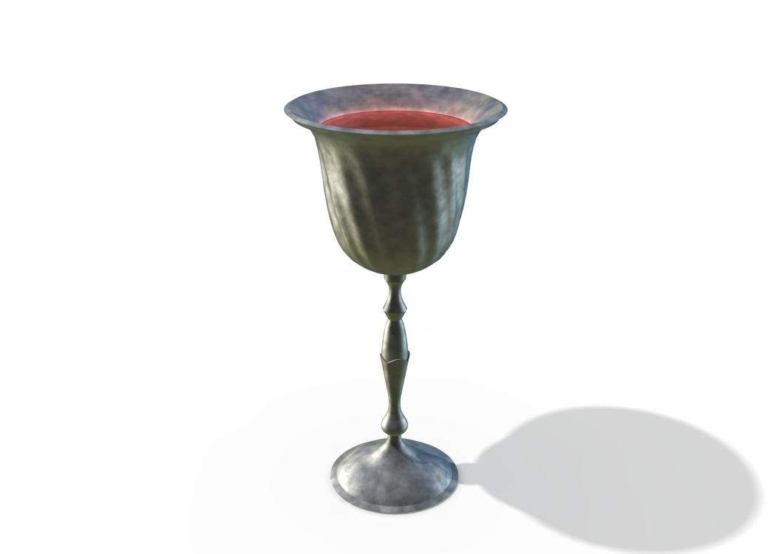
Cup of the Covenant
As a symbol of the covenant relationship that had been established, the groom and bride would drink from the cup of wine over which a betrothal benediction had been pronounced.
When the bride drank the wine it was a symbol of her acceptance of the marriage.

Slide 9
Bought With A Price
After this the bride has “been bought with a price” and she is not her own. All of her loyalty and the focus of her life is on her husband.
1 Corinthians 6:19-20, “What? know ye not that your body is the temple of the Holy Ghost which is in you, which ye have of God, and ye are not your own? 20, For ye are bought with a price: therefore glorify God in your body, and in your spirit, which are God's.”

Slide 10
The Promise to Return
After the marriage covenant had been established, the groom gave a promise similar to John 14:2&3,
“In my Father's house are many mansions: if it were not so, I would have told you. I go to prepare a place for you. And if I go and prepare a place for you, I will come again, and receive you unto myself; that where I am, there ye may be also.”

Slide 11
The Period of Espousal
After the promise to return, the groom would leave the home of the bride and return to his father's house.
There he would remain separate from his bride for a period of twelve months to two years.
It was during this time that Mary announced to Joseph that she was with child.

Slide 12
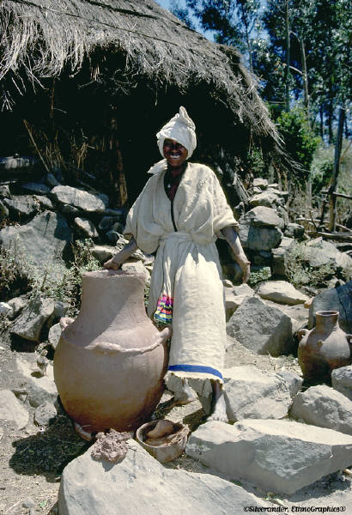
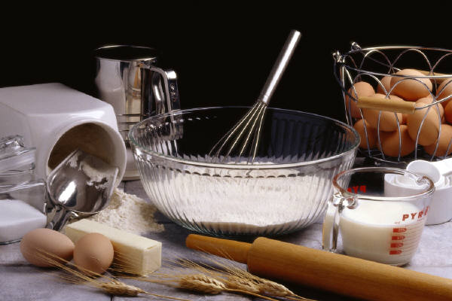
The Trousseau
This period of separation afforded the bride time to gather her trousseau and to prepare for married life.

Slide 13
Preparation For Marriage
The groom prepared the living accommodations in his father's house to which he could bring his bride.

Slide 14
The Father’s House

Slide 15
The Arrival of the Groom
At the end of the period of separation the groom would come to take his bride to live with him.
The taking of the bride usually took place at night.
The groom, the best man, and other male escorts would leave the groom's father's house and conduct a torch light procession to the home of the bride.

Slide 16
The Bride Caught Away
Although the bride was expecting her groom to come for her, she did not know the exact time of his coming.
Therefore the groom's arrival would be preceded by a shout.
This shout would forewarn the bride to be prepared for the coming of the groom.
Those coming before the groom would cry, “Behold, the bridegroom is coming.”

Slide 17
The Marriage Supper
After the groom received his bride and her female attendants, the enlarged wedding party would return to the groom's father's house.
When the wedding party arrived they would find that the wedding guests were already assembled. These are the friends of the bride and groom.

Slide 18
Friends of the Wedding Party
The Old Testament saints are the friends of the bride and groom. John the Baptist announced himself as a friend of the groom.
“Ye yourselves bear me witness, that I said, I am not the Christ, but that I am sent before him. He that hath the bride is the bridegroom: but the friend of the bridegroom, which standeth and heareth him, rejoiceth greatly because of the bridegroom's voice: this my joy therefore is fulfilled. He must increase, but I must decrease.” John 3:28-30.

Slide 19
The Consummation
Shortly after arrival the bride and groom would be escorted by the other members of the wedding party to the bridal chamber (huppah). Prior to entering the chamber the bride remained veiled so that no one could see her face.
While the groomsmen and bridesmaids waited outside, the bride and groom would enter the bridal chamber alone. There in the privacy of that place they would enter into physical union for the first time, thereby consummating the marriage that had been covenanted earlier.

Slide 20
The Marriage Supper
After the marriage was consummated, the wedding guests would feast and make merry for the next seven days.
This seven days is parallel to the seven years of tribulation and the judgment the King begins to unleash upon the earth.

Slide 21
The Marriage Vow
"I, Jesus, take thee, Sinner, to be My Bride. And I do promise and covenant before God The Father and these witnesses, to be thy loving and faithful Savior and Bridegroom; in sickness and in health, in plenty and in want, in joy and in sorrow, in faithfulness and in waywardness, for time and for eternity."

Slide 22
The Proposal
Just as the proposal that the Jewish bridegroom made could be accepted or rejected, so Christ's proposal to you can be accepted or rejected.
If you reject it throughout this lifetime, then you never will be rightly related to Jesus Christ.
The tragic result will be that you will spend eternity separated from God and Christ in the eternal lake of fire (Rev.20:11-15).

Slide 23
Accept Christ’s Proposal
If, however, you accept Christ's proposal, then your sins will be forgiven, and you will enter into that relationship that makes you part of His Bride, the Church.
In addition, you will go to be with Him when He comes to take the Church, and you will remain with Him forever in great blessing.

Slide 24
Accept Christ’s Proposal
The way in which you can accept Christ's proposal is quite simple.
If you sincerely believe that Jesus Christ is the Son of God and that He came to this earth, died for your sins and rose from the dead, then respond to Him as follows:

Slide 25
Accept Christ’s Proposal
"I, sinner, take Thee, Jesus, to be my Savior. . . And I do promise and covenant before God and these witnesses to be Thy loving and faithful Bride; in sickness and in health, in plenty and in want, in joy and in sorrow, for time and for eternity.“ From: http://www.biblestudymanuals.net/jewish_marriage_customs.htm

Slide 26
The Rapture of the Church
1 Thessalonians 4:16-18, “For the Lord himself shall descend from heaven with a shout, with the voice of the archangel, and with the trump of God: and the dead in Christ shall rise first: 17, Then we which are alive and remain shall be caught up together with them in the clouds, to meet the Lord in the air: and so shall we ever be with the Lord. 18, Wherefore comfort one another with these words.”

Slide 27
The Rapture
1 Corinthians 15:51-53 “Behold, I shew you a mystery; We shall not all sleep, but we shall all be changed, 52, In a moment, in the twinkling of an eye, at the last trump: for the trumpet shall sound, and the dead shall be raised incorruptible, and we shall be changed. 53, For this corruptible must put on incorruption, and this mortal must put on immortality.”

