Slide 3
Announcements
Men’s fellowship breakfast Mondays
@ 8:00 AM
LWC Fellowship Hall

Slide 4
Announcements
Living Waters Ladies’ Ministry
Meets Tuesday, June 21, 10:00 AM In the LWC Sanctuary

Slide 5
Announcements
Don’t forget to Silence Your Cell Phone During Worship Service

Slide 6
Announcements
Ladies Morning Prayer
8:30 – 9:30 AM
Every Monday in the Sanctuary

Slide 7
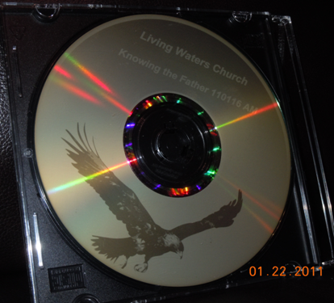
Announcements
CD’s of Sermons @ LWC Are Now Available for $3.00. See Bob Price

Slide 8
Announcements
Octane Youth Ministry
Friday Nights,
Cornerstone Community Church,
9745 N. Trekell Road (at Val Vista),
7 to 10:00 PM, for ages 10 to 14.
This high-energy evening includes snacks and drinks, ping pong, air hockey, pool, foosball, Wii station, and more!

Slide 9
Today is Father’s Day!
What will you do to honor your father?
“Honor thy father and thy mother that thy days may be long upon the land.” Ex. 20:12

Slide 14
