Slide 1
I. The Problem.
Many families are under a curse.
This is not a curse performed by some witch doctor, but a curse produced by neglect of the Scripture and wrong doctrine.
Malachi 4:5-6, KJV
5, “Behold, I will send you Elijah the prophet before the coming of the great and dreadful day of the LORD:”
6, “And he shall turn the heart of the fathers to the children, and the heart of the children to their fathers, lest I come and smite the earth with a curse.”

Slide 2
The Problem
The curse is the disorder and confusion of the world, the lack of Kingdom Order.
The curse is a financial curse.
Families overspend on items or buy things twice because they cannot find them in their clutter and confusion.

Slide 3
The Problem
The parenting “experts” tried to define “love” as permissiveness toward children.
In an effort not to be abusive they abused children in a worse way.
They abused them in that they encouraged parents to shield their children from responsibilities or consequences of their actions.
America’s homes began to be ruled by six-year-old tyrants.

Slide 4
The Problem
Isaiah 3:1-3
1, “For, behold, the Lord, the LORD of hosts, doth take away from Jerusalem and from Judah the stay and the staff, the whole stay of bread, and the whole stay of water,”
2, “The mighty man, and the man of war, the judge, and the prophet, and the prudent, and the ancient,”
3, “The captain of fifty, and the honourable man, and the counsellor, and the cunning artificer, and the eloquent orator.”

Slide 5
The Problem
Isaiah 3:4-5
4, “And I will give children to be their princes, and babes shall rule over them.”
5, “And the people shall be oppressed, every one by another, and every one by his neighbour: the child shall behave himself proudly against the ancient, and the base against the honourable.

Slide 6
The Problem
Isaiah 3:12, KJV, “As for my people, children are their oppressors, and women rule over them. O my people, they which lead thee cause thee to err, and destroy the way of thy paths.”

Slide 7
II. The Solution.
Ephesians 6:1-4, KJV
1, Children, obey your parents in the Lord: for this is right.
2, Honour thy father and mother; (which is the first commandment with promise;)
3, That it may be well with thee, and thou mayest live long on the earth.
4, And, ye fathers, provoke not your children to wrath: but bring them up in the nurture and admonition of the Lord.

Slide 8
The Solution
Colossians 3:1-3 KJV
1, If ye then be risen with Christ, seek those things which are above, where Christ sitteth on the right hand of God.
2, Set your affection on things above, not on things on the earth.
3, For ye are dead, and your life is hid with Christ in God.

Slide 9
The Solution
Colossians 3:12-15, KJV
12, Put on therefore, as the elect of God, holy and beloved, bowels of mercies, kindness, humbleness of mind, meekness, longsuffering;
13, Forbearing one another, and forgiving one another, if any man have a quarrel against any: even as Christ forgave you, so also do ye.
14, And above all these things put on charity, which is the bond of perfectness.
15, And let the peace of God rule in your hearts, to the which also ye are called in one body; and be ye thankful.

Slide 10
The Solution
16, Let the word of Christ dwell in you richly in all wisdom; teaching and admonishing one another in psalms and hymns and spiritual songs, singing with grace in your hearts to the Lord.
17, And whatsoever ye do in word or deed, do all in the name of the Lord Jesus, giving thanks to God and the Father by him.
18, Wives, submit yourselves unto your own husbands, as it is fit in the Lord.

Slide 11
The Solution
19, Husbands, love your wives, and be not bitter against them.
20, Children, obey your parents in all things: for this is well pleasing unto the Lord.
21, Fathers, provoke not your children to anger, lest they be discouraged.

Slide 12
The Solution
Proverbs 14:11-12 KJV The house of the wicked shall be overthrown: but the tabernacle of the upright shall flourish. 12, There is a way which seemeth right unto a man, but the end thereof are the ways of death.

Slide 13
The Solution
Proverbs 14:15-18 KJV The simple believeth every word: but the prudent man looketh well to his going. 16, A wise man feareth, and departeth from evil: but the fool rageth, and is confident. 17, He that is soon angry dealeth foolishly: and a man of wicked devices is hated. 18, The simple inherit folly: but the prudent are crowned with knowledge.

Slide 14
The Solution
Proverbs 23:12-14 KJV Apply thine heart unto instruction, and thine ears to the words of knowledge. 13, Withhold not correction from the child: for if thou beatest him with the rod, he shall not die. 14, Thou shalt beat him with the rod, and shalt deliver his soul from hell.

Slide 15
The Solution
The worst kind of child abuse is to let your children ignore you and be undisciplined.
Discipline prepares children for the real world.
If you love your children you will correct them.

Slide 16
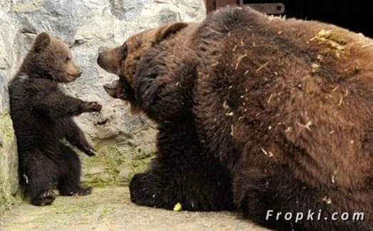

Slide 17
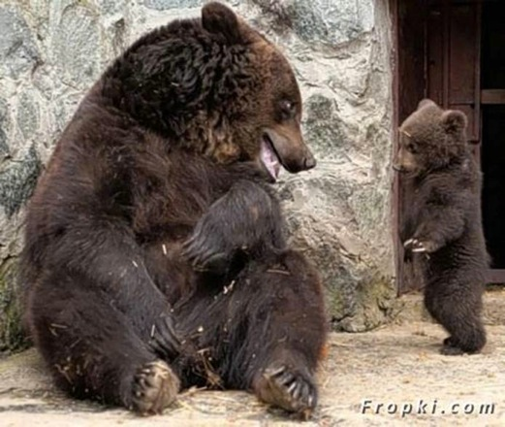

Slide 18
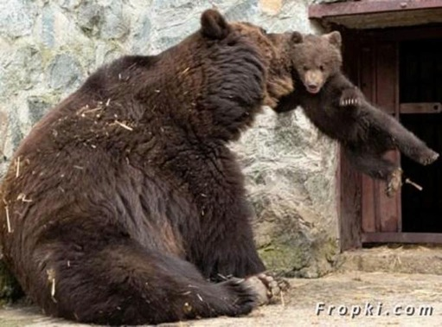

Slide 19
