Slide 1
Chronological Order of the Pauline Epistles
Louis G. Hulsey
August 26, 2012
Casa Grande, Arizona

Slide 2
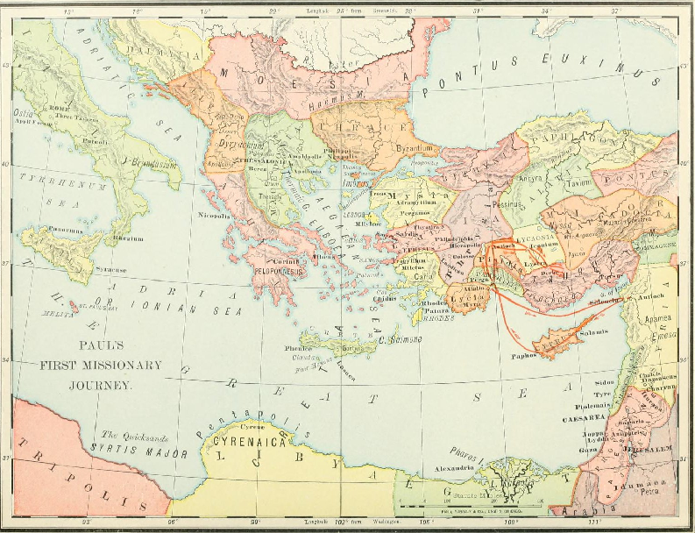
©Public Domain

Slide 3
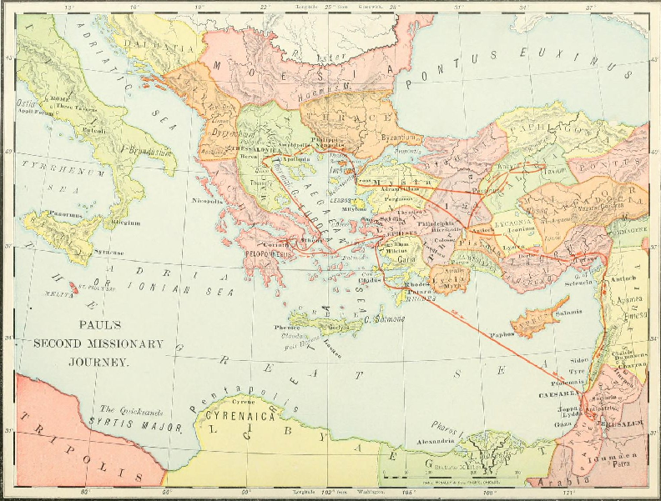
©Public Domain

Slide 4
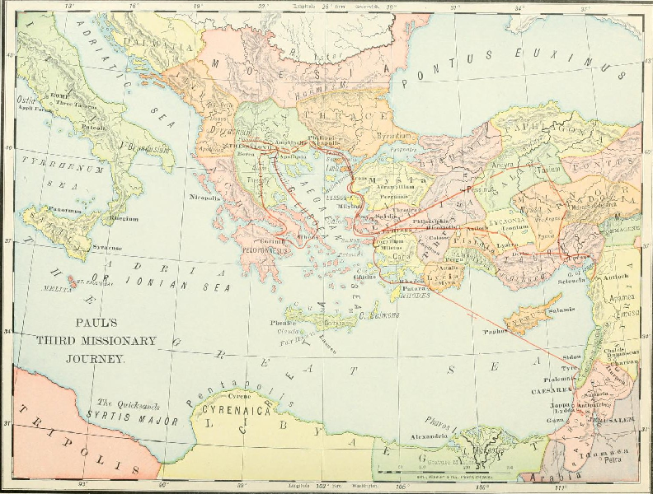
©Public Domain

Slide 5
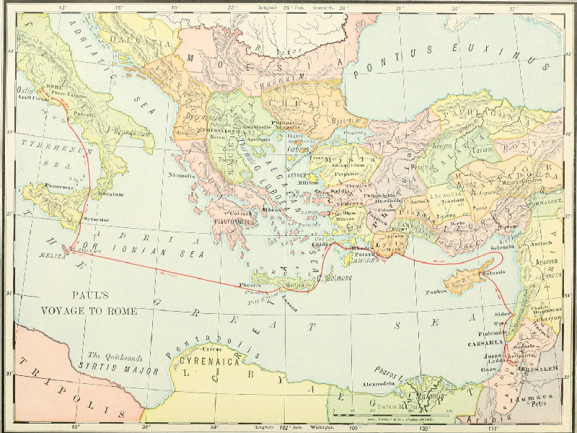
©Public Domain

Slide 6
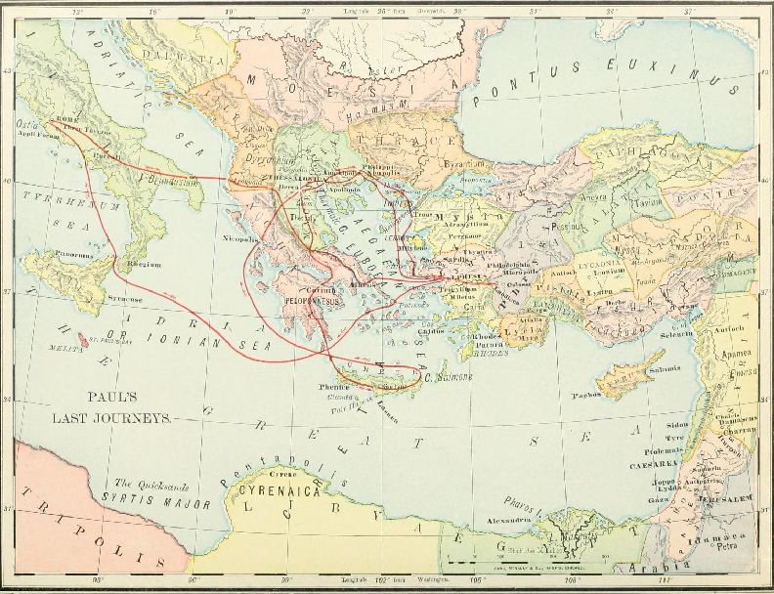
©Public Domain

Slide 7
Paul’s Last Letter
After Paul appealed to Caesar, was shipwrecked, and landed in Rome, he was tried before the high court of Rome and not found guilty of any crime worthy of death.
Paul was given freedom to minister in Rome.
Luke writes, “And Paul dwelt two whole years in his own hired house, and received all that came in unto him, 31, Preaching the kingdom of God, and teaching those things which concern the Lord Jesus Christ, with all confidence, no man forbidding him,” Acts 28:30-31.

Slide 8
Writing the Book of Acts
Luke probably completed the book of Acts during Paul’s days of freedom in Rome and before Paul left to travel on his final trip back to Ephesus. (See Map of Paul’s Final Journeys).
In II Timothy Paul describes his first trial and prosecution in Rome.

Slide 9
Paul’s Final Words
2 Timothy 4:5-8
5, “But watch thou in all things, endure afflictions, do the work of an evangelist, make full proof of thy ministry.”
6, “For I am now ready to be offered, and the time of my departure is at hand.”
7, “I have fought a good fight, I have finished my course, I have kept the faith:”
8, “Henceforth there is laid up for me a crown of righteousness, which the Lord, the righteous judge, shall give me at that day: and not to me only, but unto all them also that love his appearing.”

Slide 10
Paul Before Nero
Paul’s companions were all gone from him, and all alone he faced the court of Rome’s worst persecutor, Nero.
2 Timothy 4:16-17
16, “At my first answer [trial] no man stood with me, but all men forsook me: I pray God that it may not be laid to their charge.”
17, “Notwithstanding the Lord stood with me, and strengthened me; that by me the preaching might be fully known, and that all the Gentiles might hear: and I was delivered out of the mouth of the lion.” [Here Paul probably refers to being delivered from Nero at his first trial.]

Slide 11
Paul’s Farewell
2 Timothy 4:18, “And the Lord shall deliver me from every evil work, and will preserve me unto his heavenly kingdom: to whom be glory for ever and ever. Amen.”
2 Timothy 4:22, “The Lord Jesus Christ be with thy spirit. Grace be with you. Amen.” The second epistle unto Timotheus, ordained the first bishop of the church of the Ephesians, was written from Rome, when Paul was brought before Nero the second time.
Paul stood firm for the cause of Christ before the Roman court, but the Early Church historian Eusebius says that Paul was beheaded by Nero apparently right after the trial.

